Slide 2
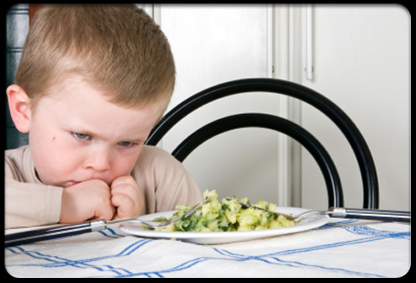

Slide 3
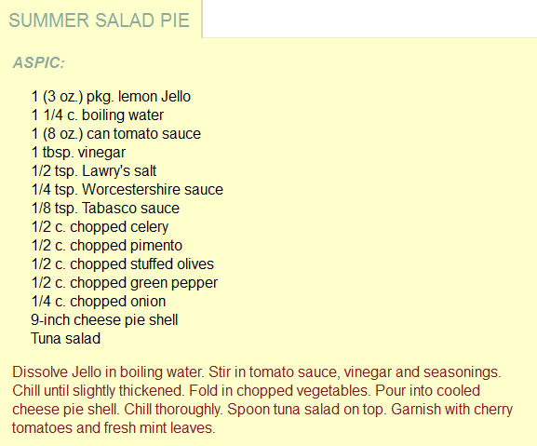
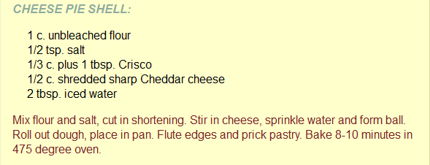
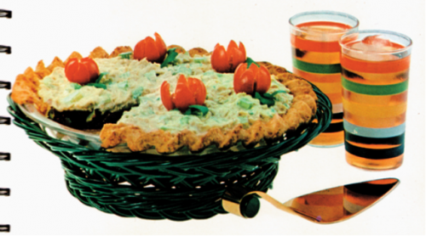
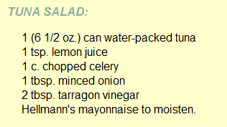

Slide 4
Why stat 101 leaves a bad taste (Aaaaa….)
Algorithms – Constrained by recipes that don’t make sense
Automation – There is no room to be creative
Abstract – We’re not making a single dish; context matters
Algebra – Students get stuck on how to do the computation
Amateurs – Many instructors’ expertise is in the wrong place

Slide 5
Leaving a good taste (moving from Aaaaa…. To aaaaaH…)
Adjust – Doing data analyses mean adjusting on the fly and being creative
Articles – Write and read data stories
Awe – Discuss real data…that matters
Apprenticeship – Study under data experts
Artisans – Practice, practice, practice (experience and aptitude)

Slide 6
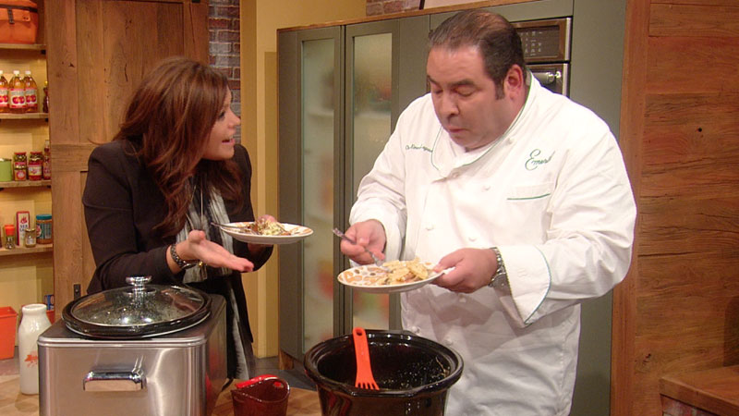
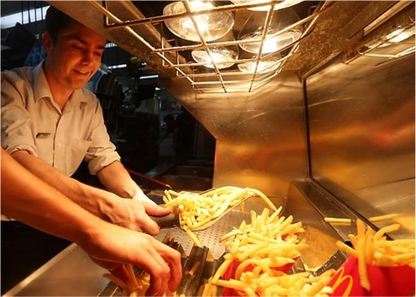

Slide 7
