Slide 1
What’s Right with Undergraduate Statistics?
Exciting Course Options

Slide 2
Cornell College
Small liberal arts college (1100 students)
Mathematics and Statistics Department with 4.5 tenure track lines
Teach on the block plan

Slide 3
Statistics History at Cornell
Intro stat
Probability/Math Stat
Stat 2
Making Connections
Epidemiology
Intro to Data Science (?)

Slide 4
Data Science
Team taught with computer scientist
Prerequisite either intro stat or CS 1
Focused on hands-on
Morning was two hours of lecture
Afternoon was two hours of computer lab

Slide 5
Topics Covered
Cleaning/manipulating data
Visualizing data
Issues surrounding “Big Data”
Computer Science fundamentals needed required for the rest of the topics

Slide 6
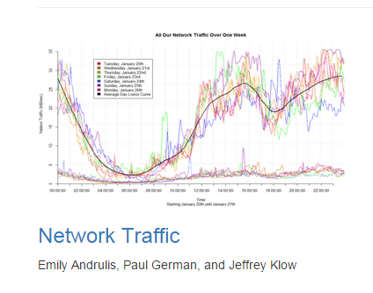
Examples of group projects

Slide 7
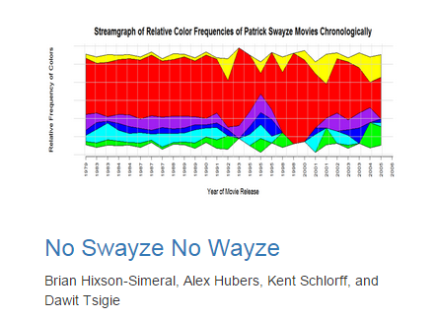
Examples of group projects

Slide 8
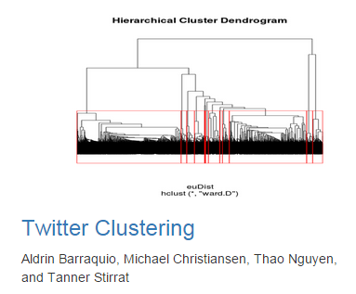
Examples of group projects

Slide 9
More Detailed Report
Ask me!
Come to JSM
Innovations and New Frontiers in Statistics Education
Session 408, Tuesday 2-3:50, CC-205

