Slide 1
IGNITING A PASSION FOR CHANGE ARSONIST OR MERE ACCELERANT?
George W. Cobb
Mount Holyoke College
GCobb@MtHolyoke.edu
USCOTS 2013
Raleigh, NC May 18

Slide 2
IGNITING A PASSION FOR CHANGE ARSONIST OR MERE ACCELERANT?
George W. Cobb
Mount Holyoke College
GCobb@MtHolyoke.edu
USCOTS 2013
Raleigh, NC May 18

Slide 3
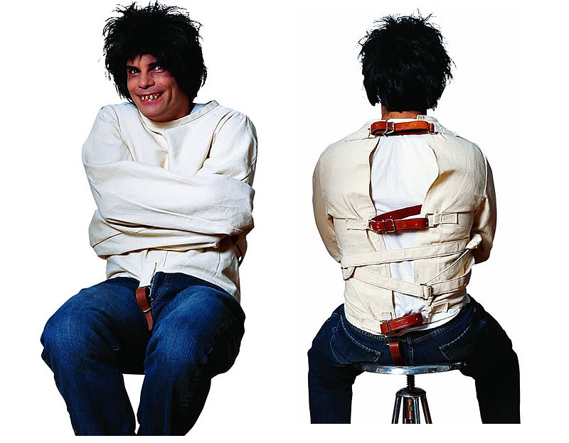

Slide 4
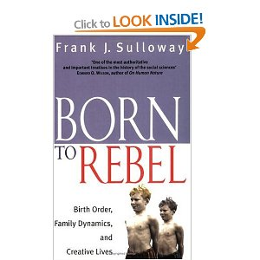

Slide 6
This page intentionally left blank

Slide 7
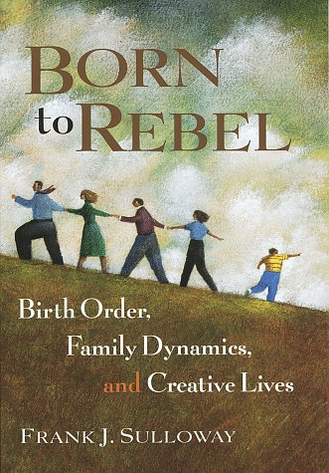

Slide 10
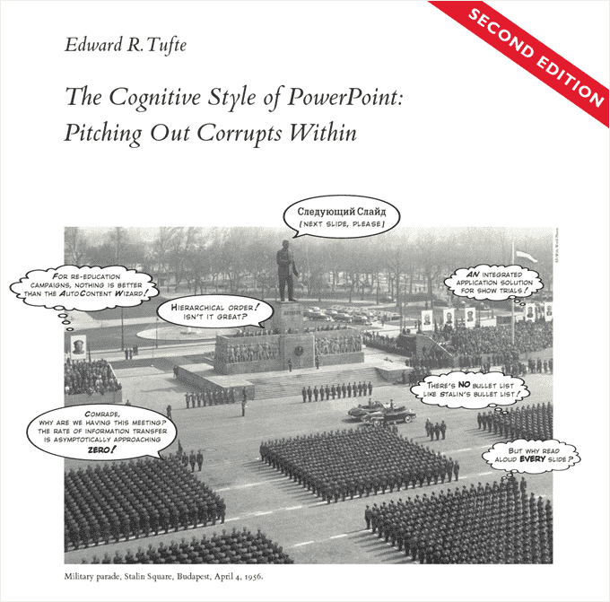
(Just for variety)

Slide 12
1. TYRANNY OF THE COMPUTABLE
How we think, and what we teach, are shaped by what we can and cannot compute

Slide 13
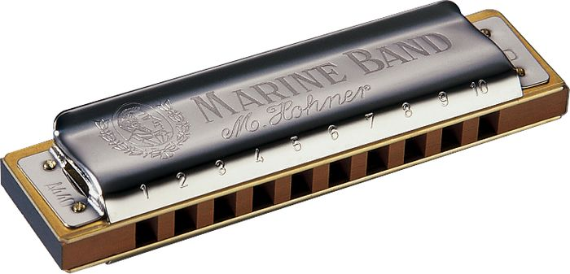
2. THE POWER OF SIMULATION
Simulation reduces computing
areas and probabilities
to counting # Yes / # Reps

Slide 14
Google Cobb, TISE

Slide 15
3. FISHER’S VISION
Fisher wanted to base p-values
on randomization,
but he didn’t have
the computing power.
We do.

Slide 16
P-VALUES AND BAYES
P-VALUES:
Does x have a detectable effect?
Does x belong in our model?
BAYES:
Posterior distributions for estimation
A.P. Dempster (1971) “Model searching and estimation in the logic of inference”

Slide 17
4. BAYESIAN INTERVALS
Only Bayesian intervals
condition on all the data,
and only on the data
we actually observed

Slide 18
5. SIMULATION FREES US TO TEACH WHAT REALLY MATTERS
It’s not just p-values
and Bayesian posteriors.
We need more time on what
Nick Horton and Danny Kaplan
talked about yesterday.

Slide 19
6. THERE IS NO STATISTICAL GRAND THEORY OF EVERYTHING
We need both p-values for model choosing
(Does x have a detectable effect?)
AND
Bayesian intervals for estimation
(once we have a tentative model)

Slide 20
IGNITING A PASSION FOR CHANGE ARSONIST OR MERE ACCELERANT?
George W. Cobb
Mount Holyoke College
GCobb@MtHolyoke.edu
USCOTS 2013
Raleigh, NC May 18

