Slide 1
K-12 Teacher Preparation in Statistics: It is No Longer Optional but Essential
Anna Bargagliotti, Loyola Marymount University
Christine Franklin, University of Georgia
Randall Groth, Salisbury University
Tim Jacobbe, University of Florida
Jennifer Kaplan, University of Georgia

Slide 2
Statistics in K-12
The recently adopted Common Core State Standards for Mathematics (CCSSM) include a large amount of statistics content in the middle and high school grades and a smaller amount at the elementary school level
The Mathematics Education of Teachers Reports (MET 1 and MET 2) have identified statistics as a large area of concern for teacher preparation at the undergraduate level
To ensure the effective implementation of the CCSSM in the classroom, there is an immediate need to provide high quality statistical preparation of teachers during their undergraduate coursework

Slide 3
Teacher Preparation
In this session, we are going to discuss how teachers should be prepared in statistics
We will also provide specific examples of teacher education materials for different K-12 grade bands that exemplify best practices

Slide 4
Let’s get started by answering some questions with our clickers to see who we all are and what we all think about this topic

Slide 5
What type of department are you in?
mathematics or mathematical sciences department
statistics department
department in a college or school of education
other department

Slide 6
Do you teach a course for pre- or in-service teachers?
yes, a content course
yes, a methods (pedagogy) course
yes, a course that includes both content and methods
no

Slide 7
If you do teach teachers, what type of course for pre- or in-service teachers do you teach?
1-semester course covering only statistics
1-year course covering only statistics
1-semester course in which statistics is one unit
1-year course in which statistics is one unit

Slide 8
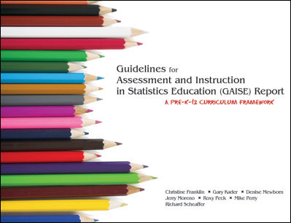
Are you familiar with the GAISE PreK-12 framework?
yes, and I use (have students read it or use the examples) it in the course I teach
yes, but I do not use it in the course I teach
yes, but I do not teach a course to pre- and in-service
a bit
no

Slide 9
Are you familiar with the Common Core State Standards?
yes, and I reference it in the course I teach
yes, but I do not reference it in the course I teach
yes, but I do not teach a course to pre- and in-service
a bit
no

Slide 10
Do you think that prospective K-5 teachers should have their own introductory statistics course, distinct from a course intended for those in other majors?
a) Yes b) No c) Maybe d) Don’t know
Do you think that prospective 6-8 teachers should have their own introductory statistics course, distinct from a course intended for those in other majors?
a) Yes b) No c) Maybe d) Don’t know
Do you think that prospective 9-12 teachers should have their own introductory statistics course, distinct from that intended for mathematics majors?
a) Yes b) No c) Maybe d) Don’t know

Slide 11
Current Landscape of K-12 Teacher Prep
Our subject is in demand across all disciplines, at all age levels, and in the work force.
Teacher preparation schools and in service professional development are rapidly trying to ‘catch up’ with statistical preparation.
Must help our teachers develop a belief that they are key to the success of preparing students for our data-centric world.

Slide 12
Do we need change?
The prevalence of technology is demanding that teachers learn skills, practices, and ways of thinking statistically they have never encountered.
Teachers are being asked to teach in the philosophy of the Pre-K-12 GAISE Framework – most teachers do not understand the statistical investigative process or the evolution of statistical concepts

Slide 13
How should we change?
The Joint Position Statement from ASA-NCTM is a must read for change – provides five recommendations summarized as:
promoting well-designed PD courses and resources
cooperation between local school districts, state DOE, national organizations (i.e., ASA and NCTM) , and teacher preparation programs.
http://www.nctm.org/uploadedFiles/About_NCTM/Position_Statements/1Statistics%20joint%20ASA%20NCTM%20statement%20021113.pdf

Slide 14
How should we change?
As a response to the Joint Position paper, ASA is supporting as an upcoming strategic initiative a team of statistics and mathematics educators, chaired by Christine Franklin and Tim Jacobbe to write a document that will provide guidance for implementing the recommendations and also as a follow up to the MET 2 recommendations in statistics.
Due out in 2014

Slide 15
In today’s session, we’ll look at examples of teacher statistical knowledge as well as example teaching materials from each grade band that fit the recommendations of the Joint Position Statement

Slide 16
K-5 Grade Band: Teacher Understanding of Nominal Categorical Data Analysis

Slide 17
K-5 Topic: Nominal Categorical Data Analysis
Nominal categorical data analysis can be motivated by gathering data from classmates on questions such as “What is your favorite beverage in the cafeteria?” (NCTM Principles and Standards, p. 110) and “What is your favorite type of music?” (GAISE K-12 Guidelines, p. 23).
Children in grades K-5 are to organize such data graphically (Common Core State Standards, K-5 Data and Measurement Strand).

Slide 18
Resources for developing teachers’ knowledge of teaching nominal categorical data analysis
Developing Mathematical Ideas cases (Russell, Schifter, & Bastable, 2002): Raise issues involved in leading children’s classroom discussions about nominal categorical data.
From Teaching Children Mathematics: “Statistics in the elementary grades: Exploring distributions of data” (Franklin & Mewborn, 2008) Distinguishes classroom activities and analyses suitable for categorical data from those for quantitative data.
From Mathematics Teaching in the Middle School: “It’s a fird! Can you compute a median of categorical data?” (Leavy et al., 2009) described a classroom activity based on a Connected Mathematics Project lesson (Lappan, Fey, Fitzgerald, Friel, & Phillips, 2006) with the goal of helping students distinguish between categorical and quantitative data. It explained how the classroom teacher dealt with students’ idea that the median is suitable for nominal categorical data.

Slide 19
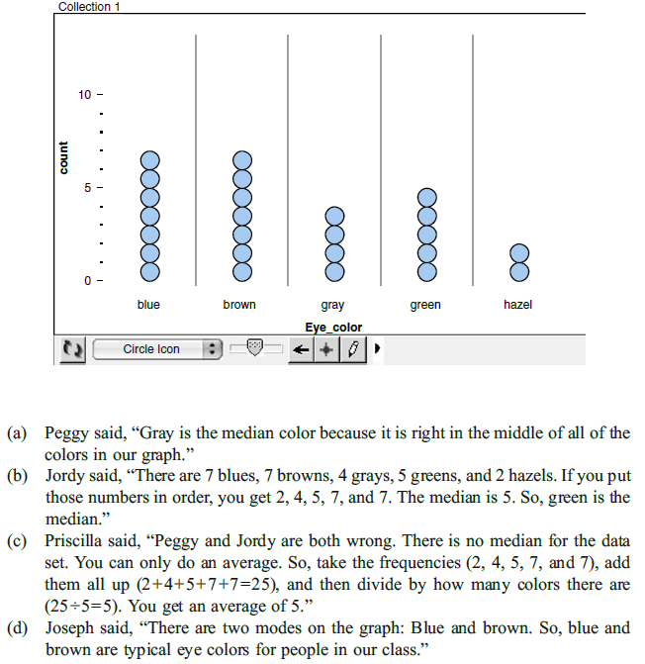
Discussion question: What kinds of difficulties might prospective teachers have in responding to children who offer these analyses of the graph shown?
Discuss first with those around you, and then be ready to share with the large group.

Slide 20
What would you do with these pre-service teacher responses? (Groth & Bergner, in press)
“Peggy’s answer is incorrect because the graph is not in sequential order. If it was, brown would be the median since one of its points is in the middle number of data points.”
“Priscilla is correct. You can only find the mean or average of this data set because it is categorical. I would support her learning by sharing exactly what the average represents and allow her to think about what it means, and why it is a good representer of this data set.”

Slide 21
What would you do with these pre-service teacher responses? (Groth & Bergner, in press)
“Gray is not the median color because of its location on the graph. The colors are displayed in alphabetical order, which still does not make gray the median. This data is categorical, not quantitative, meaning there is no real reason for the order and there is no median.”
“Jordy did not arrange the data in a logical order because she just took the top number from each bar graph. The correct way would be to write out ‘blue’ 7 times, ‘brown’ 8 times, ‘gray’ 4 times, etc. and then find the median.”

Slide 22
6-8 Grade Band: Variability in Data and Distributions & Comparing Distributions

Slide 23
NCTM’s Essential Understanding Series
Gary Kader & Tim Jacobbe
Developing essential understanding of statistics for teaching mathematics in grades 6-8.
Roxy Peck, Rob Gould, & Stephen Miller
Developing essential understanding of statistics for teaching mathematics in grades 9-12.
Spring 2013/Available Now!

Slide 24
Big Ideas for Grades 6-8: Statistics is a Problem Solving Process
Variability in Data and Distributions
Comparing Distributions
Association between two variables
Samples and populations

Slide 25
Big Idea 2: Comparing Distributions
How do the fizz times for two brands of effervescent tablets compare?
25 Fizz Times for each of two brands of effervescent tablets/Parallel Dotplots

Slide 26
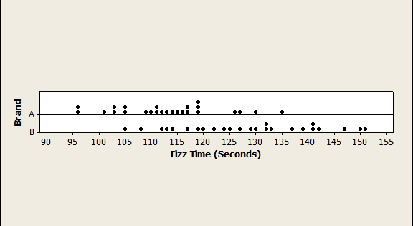
Comparing Fizz Time Overlap versus Separation

Slide 27
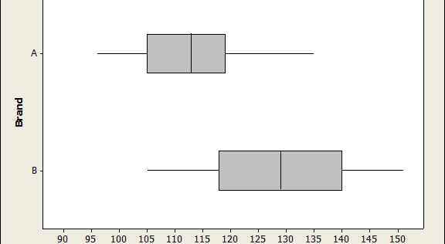
Comparing Fizz Time Overlap versus Separation

Slide 28
Difference In Medians = 16
Summary | Brand A | Brand B
Minimum | 96 | 105
First quartile | 105 | 118
Median | 113 | 129
Third quartile | 119 | 140
Maximum | 135 | 151
IQR | 14 | 22
Range | 39 | 46

Slide 29
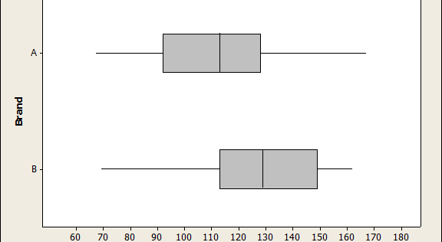
Hypothetical Fizz Times

Slide 30
Difference In Medians = 16
Summary | Brand A | Brand B
Minimum | 67 | 69
First quartile | 92 | 113
Median | 113 | 129
Third quartile | 128 | 149
Maximum | 167 | 162
IQR | 36 | 36
Range | 100 | 93

Slide 31
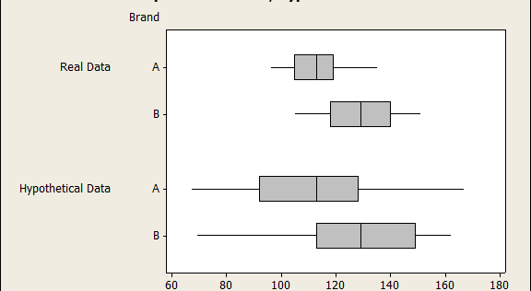
Real Versus Hypothetical Fizz Times

Slide 32
Medians/IQRs
 | Brand A | Brand B
Median/IQR (Real Data) | 113/14 | 129/22
Median/IQR (Hypothetical Data) | 113/36 | 129/36

Slide 33
For which set of Fizz Times (Real versus Hypothetical) is the difference between Medians more meaningful?
• CCSSM suggests that the magnitude of a difference between two centers can be assessed by "expressing it as a multiple of a measure of variability."

Slide 34
When is a difference meaningful?
When comparing two medians, the larger the quantity
the more meaningful the difference between the two medians is.
Note: Use the larger IQR

Slide 35
When is a difference meaningful?
When comparing two means, the larger the quantity
the more meaningful the difference between the two means is.
Note: Use the larger MAD

Slide 36
Meaningful Differences
For the real fizz time data, we will use the larger IQR for Brand B (22) as the divisor here.
Real Data: = .73 Hypothetical Data: = .44
Thus, the difference between medians is more meaningful for the real data than for the hypothetical data. This illustrates why variability in data is of utmost importance in statistics.

Slide 37
Summary/Conclusion
Statistics as a problem solving process
The role of variability
Changing what students experience
Changing the preparation of teachers to teach statistics
Essential Understandings will hopefully help

Slide 38
9-12 Grade Band: Analysis of Bivariate Data

Slide 39
CCSSM 9 – 12: Bivariate Data Analysis
HSS-ID.B.5: Summarize categorical data for two categories in two-way frequency tables. Interpret relative frequencies in the context of the data (including joint, marginal, and conditional relative frequencies). Recognize possible associations and trends in the data.
HSS-ID.B.6: Represent data on two quantitative variables on a scatter plot, and describe how the variables are related.
6a: Fit a function to the data; use functions fitted to data to solve problems in the context of the data. Use given functions or choose a function suggested by the context. Emphasize linear, quadratic, and exponential models.
6b: Informally assess the fit of a function by plotting and analyzing residuals.
6c: Fit a linear function for a scatter plot that suggests a linear association.
HSS-ID.B.7: Interpret the slope and the intercept of a linear model in the context of the data.
HSS-ID.B.8: Compute (using technology) and interpret the correlation coefficient of a linear fit.
Notes:
There are many outcomes in the CCSSM 9 – 12 devoted to bivariate data analysis. One of our goals is to prepare teachers to teach these outcomes infusing the spirit of the GAISE in their teaching.

Slide 40
Bivariate Data
Data that has two variables
Typically, we want to explore the relationship between the two variables
Our goal is to get teachers to think about how to approach bivariate data analysis without providing them with a step-by-step formulaic list
We want teachers to:
Be able to identify the appropriate analysis procedures given the data and driving question at hand
Be able to carry out the analysis procedures
Our approach today is to show you a hands on sample activity to prepare high school teachers to teach bivariate data analysis

Slide 41
Example: Height, Jumps & Sports
Ms. K’s class is interested in exploring the relationship between a person’s height and his/her ability to jump vertically as well as the relationship between their gender and whether they like sports. To do this, the class decides to measure the height and vertical jump ability of each student in the class using a specific test procedure. The procedure consists of taping measuring tapes to the wall and measuring the height of a person as well as how high they jump. To reduce measurement variation and increase accuracy, the same person will measure all the vertical jumps. Additionally, each student will jump 3 times and their biggest jump of the three will be recorded.
After completing the jump measurement, each student is asked to record their gender and answer the question: “Do you like to play sports?”
Here are the data collected in one class.

Slide 42
Data
Gender | Height | Vertical Jump Height | Likes Sports
male | 72.5 | 22.5 | Yes
female | 70 | 18.5 | Yes
male | 71 | 17 | No
female | 64 | 17 | No
female | 69 | 16.5 | Yes
male | 72.5 | 27.5 | Yes
female | 64.75 | 12.5 | Yes
male | 70 | 16 | Yes
female | 67.5 | 5.5 | No
female | 66 | 12 | Yes
male | 65.5 | 20.5 | Yes
female | 66.75 | 13.5 | No
female | 59.25 | 11 | No
male | 69.25 | 16 | No

Slide 43
Two-Way Tables and Bar Charts
Summarize the responses of student’s gender and whether the student likes sports in a two-way frequency table
Using the frequency table, answer the following:
Is there evidence in this class sample of a positive association between liking gender and liking sports? Justify your answer by pointing out a feature of the table that supports it
Can Height and Vertical Jump be summarized in a two-way frequency table? Explain why or why not.

Slide 44
Bivariate Data Analysis: Categorical Variables
Because height and jump height are continuous variables, they can be displayed in a scatter plot
As continuous variables the height and jump height cannot be summarized in a two-way table
However, these data may be summarized in a two-way table if new variables are defined that group the data into categories (i.e., construct categorical variables from the continuous variables)
There appears to be an association between gender and liking sports. For example, ¾ of the males like sports while ½ of the females report liking sports
 |  | Likes Sports
 |  | Yes | No
Gender | Male | 6 | 2
 | Female | 4 | 4

Slide 45
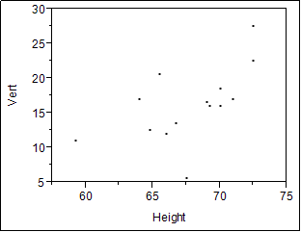
Bivariate Quantitative Variables
Looking at the scatter plot for Height and Vertical Jump, does there appear to be a pattern? If so, describe it.
Would you consider the pattern to be strong, moderate, or weak?
Sketch what you consider to be the “line of best fit” for the data. Find the approximate equation of this line without using a computer.
When you drew the “line of best fit”, how did you decide to draw the line?
Why don’t all the data points lie on the line of best fit?

Slide 46
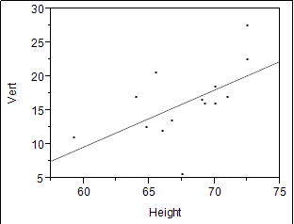
Interpretation
The equation of the least-squares line for these data is:
Est Vertical Jump = -40.76 + 0.84*Height
What is the meaning of the slope of the line in the context of this problem?

Slide 47
Summary/Conclusions
There are different approaches to bivariate data analysis depending on whether your variables are categorical or quantitative
We want teachers to recognize the appropriate analysis approaches
Make pictures!
We want teachers to make pictures (tables, scatter plots) before doing numerical analyses
There are differences between statistical models and deterministic models
We want teachers to point out the differences since they will most likely be teaching bivariate data analysis along with linear functions

Slide 48
Conclusions
There is lots of work to be done in teacher prep at all grade levels to address the needs of the CCSS-M and GAISE
Today we have provided examples of teacher’s needs and thoughts as well as examples of lessons to be used with teachers
Here is a list of resources and references related to K-12 teacher prep

Slide 49
Thank you!
Contact Information:
Anna Bargagliotti: abargagl@lmu.edu
Christine Franklin: chris@stat.uga.edu
Randall Groth: REGROTH@salisbury.edu
Tim Jacobbe: jacobbe@coe.ufl.edu
Jennifer Kaplan: jkaplan@uga.edu

Slide 50
Do you think that prospective K-5 teachers should have their own introductory statistics course, distinct from a course intended for those in other majors?
a) Yes b) No c) Maybe d) Don’t know
Do you think that prospective 6-8 teachers should have their own introductory statistics course, distinct from a course intended for those in other majors?
a) Yes b) No c) Maybe d) Don’t know
Do you think that prospective 9-12 teachers should have their own introductory statistics course, distinct from that intended for mathematics majors?
a) Yes b) No c) Maybe d) Don’t know

