Slide 1
Moving Forward to USING the MASDER Team’s Instruments
eCOTS 2024
Marjorie E. Bond (The Pennsylvania State University),
Alana Unfried (California State University Monterey Bay),
April Kerby-Helm (Winona State University),
Michael A. Posner (Villanova University),
Douglas Whitaker (Mount Saint Vincent University),
Leyla Batakci (Elizabethtown College)
DUE-2013392

Slide 2
Motivational Attitudes toward Statistics and Data Science Education Research

Slide 3
Notes:
In 2017, the team developed this model linking the student, instructor and the environment with the bjective of creating instruments to measure specific elements for researchers because…

Slide 4
In order to understand what interventions are successful, we need accurate instruments to measure what we hope to change or measure.
Notes:
We need instrument founded in theory and that are well developed to determine if specific interventions make a difference in student learning.

Slide 5
Survey of Motivational Attitudes toward
Environment, Pedagogy, Institution, Course
 | Student Instrument | Instructor Instrument | Environment Inventory
Statistics | S-SOMAS | I-SOMAS | EPIC - S
Data Science | S-SOMADS | I-SOMADS | EPIC - DS
Notes:
The two fields of interest are Statistics and Data Science, and we have Survey of Motivational Attitudes toward the field, known as the SOMA … which becomes S- SOMAS or SOMADS for Students, or I-SOMA for instructor, then we have the EPIC inventories to. Today, I will concentrate on the SOMA portion of these instruments S and I

Slide 7
Notes:
Here is our student model, this gray area is measured by Global beliefs and identity items which are given at the end of these slides, For background, we wrote and tested demographic and characteristic questions for students and instructors. For the remaining teal area, we currently have 54 items that measure each of these constructs. In which we measure, Goals and Self-Schemata, then Subjective Task Values, and next Difficulty and Expectancies. I will quickly cover the next slides with construct definitions and examples of items.

Slide 8
Goal Orientation (6 items)
Academic Self Concept (7 items)
I want to learn statistics so that I will look smart.
I need to know statistics because someone important to me wants me to.
I am good at learning new things
I know how to prioritize my time to accomplish goals.
Notes:
Goal Orientation: What intrinsic and extrinsic forces that drive student to learn statistics or data science (the field)
Academic Self Concept: is the Self-perception about academic achievement in general

Slide 9
Interest / Enjoyment Value (6 items)
Attainment Value (7 items)
I find statistics boring.
I would feel good about myself if peers came to me for statistical advice.
I am curious about statistics.
I am interested in learning more about statistics.
Doing well in statistics is important to my sense of self.
Notes:
The first subject task value measures the interest / enjoyment from doing or learning statistics or data science
Attainment Value: measures the importance of success in statistics or data science to one’s identity

Slide 10
Utility Value (9 items)
Costs and Benefits (9 items)
I need to know statistics to satisfy employers.
I value statistics because it makes me an informed citizen.
Acquiring statistics skills is worth the effort.
I will rarely use statistics in the future.
Learning statistics is worth being frustrated at times.
I prioritize other tasks over learning statistics.
Notes:
Utility: measures the student’s why or the value of statistics or DS for achieving their goals.
Cost & Benefits are those factors that push or deter students to learn statistics or DS

Slide 11
Difficulty (5 items)
Expectancies (5 items)
Learning statistics is hard for me.
I am able to explain statistical results to others.
I have trouble understanding statistics.
I am confident I can interpret graphs.
I can use data to make appropriate decisions.
Notes:
Difficulty: how difficulty that the student perceives the field
Expectancies: the student’s perception of their ability to perform specific tasks in the field

Slide 13
Instructor Background, Aptitude
Notes:
This instructor model is similar to the students’ model, except we are interested in teaching statistics instead of learning statistics. We have the Instructor demographic and characteristic questions. The almon color indicates the 10 constructs that the I-SOMAS is measuring with 68 items currently. Here we have split Goal orientation and Cost / Benefits into teaching specifically in the field or teaching in general, Lastly, we have the need to measure the overall environment that the students and instructor interact with the

Slide 14
EPIC Inventories
Environment
Pedagogy
Institution
Course
Notes:
EPIC Inventories, Environment, Pedagogy, Institution and Course … These inventories are divided into two parts ..

Slide 15
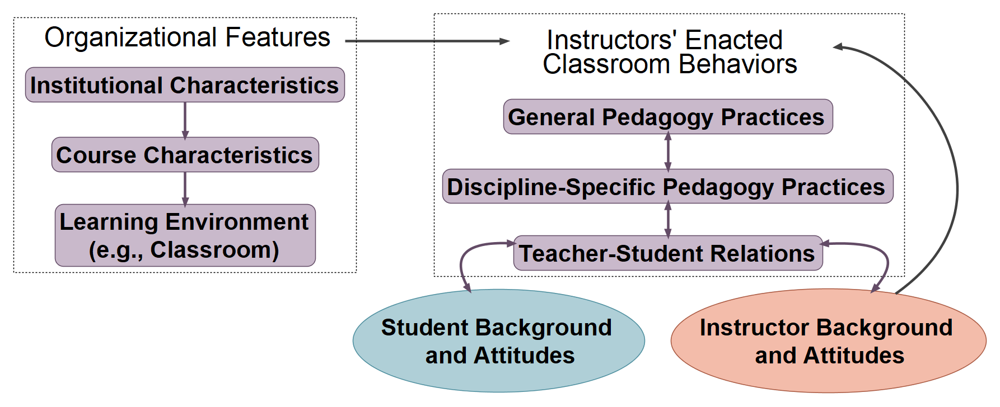
Notes:
The Pre-EPIC obtains information that the instructor can give us at the beginning of the semester, and the Post-EPIC is for the behaviors that occurred in the classroom. Due to time constraints, this is all that you get to see of the EPIC inventories.

Slide 16
What’s Next….
Website interface for survey implementation and dissemination of results
Used during our Full implementation
Create your own survey instances and get reports of results.
Publicly available for use Spring 2025!
Joint Statistical Meetings, Portland, OR
Wednesday, Aug. 7th, 8:30 – 10:20
To learn more: SDSattitudes.com
Notes:
WEBSITE to administer our instruments – create your own survey instances and obtain the data.
More information about these instruments will be given at JSM…..
There is always SO MAS to do!

Slide 17
Global Beliefs (3 items)
If somebody is not good at math, they will not be good at statistics either.
Statistics are often misused to support certain viewpoints.
Statistics can never be trusted.

Slide 18
Global Identity (5 items)
How well have you done in mathematics courses you have taken in the past?
How good are you at mathematics?
In the field in which you hope to be employed when you finish school, how much will you use statistics?
How confident are you that you can master introductory statistics material?
If the choice had been yours, how likely is it that you would have chosen to take any course in statistics?

Slide 19
Abstract
Learn about the family of instruments created by the MASDER team (Motivational Attitudes toward Statistics and Data Science Education Research) to measure students’ attitudes toward statistics and data science (SDS), instructors’ attitudes toward teaching SDS, and the environment in which the two interact. The attitude instruments are based on educational theory and were developed using a rigorous process that included results from over 8,000 students across the United States at over 50 institutions over several years. The environment inventories can help researchers identify salient elements of the institution, course, classroom, pedagogy, and the teacher-student relationship. Instructors and researchers will be able to administer these instruments using a website created by the MASDER team. Through the website, instructors can access their data and will be able to create a summary report of their students’ results compared to a national sample. This project is an NSF-funded grant (DUE-2013392). This poster will give an overview of the project, the process to develop the surveys, the specific constructs that are measured by the student and instructor instrument, the specific elements measured by the environment inventory, and the website portal.

Slide 20
Acknowledgements and Additional Information
This material is based upon work supported by the National Science Foundation under Grant No. DUE-2013392. The opinions, findings, and conclusions or recommendations expressed are those of the author(s) and do not necessarily reflect the views of the National Science Foundation.
This work was done by the Motivational Attitudes in Statistics and Data Science Education Research (MASDER) group. This group is supported by the National Science Foundation grant DUE-2013392: Developing Validated Instruments to Measure Student/Faculty Attitudes in Undergraduate Statistics and Data Science Education (10/01/2020 - 09/30/2024) and was previously supported by the American Statistical Association (ROSA 2016 - 2017, PI Marjorie E. Bond). The research team includes:
Alana Unfried, PhD, California State University Monterey Bay
Douglas Whitaker, PhD, Mount Saint Vincent University
Marjorie E. Bond, PhD, The Pennsylvania University UP
April T. Kerby-Helm, PhD, Winona State University
Michael A. Posner, PhD, PStat®, Villanova University
Leyla Batakci, PhD, Elizabethtown College

