Slide 1
Weekly Statistical Activities to Support Students' Learning Experience
Asal Aslemand
Yusuf Emre Kenaroglu
Zhengyang Fei
Dylan Galego

Slide 2
Statistics with Applied Probability
Core course in our undergraduate statistics curriculum.
Offered every term (Fall, Winter, Summer).
12-week duration; 3 hours of lectures + 1 hour of tutorials weekly.
Enrollment: Approximately 150 students per term.
Objectives: Develop data analysis skills via R, and improve statistical communication.
Topics covered: Data exploration, sampling distributions, estimations, hypothesis testing, count data analysis, linear regression.
Notes:
https://www.rstudio.com/about/logos/

Slide 3
Course Assessment
Previous Offerings of the Course:
Weekly quizzes
Two term tests
Final exam
Current Offerings of the Course:
Weekly tutorial participations, including preparations (pre-task tutorial activities), and reflections
One term test
Final exam

Slide 4
Guidelines for Assessment and Instruction
in Statistics Education (GAISE)
College Report College 2016
GAISE Recommendations:
Teach statistical thinking.
Focus on conceptual understanding.
Integrate real data with a context and a purpose.
Foster active learning.
Use technology to explore concepts and analyze data.
6. Use assessments to improve and evaluate student learning.

Slide 5
Foster Active Learning in Statistics Classroom
Curiosity in students.
Technology to explore conceptual ideas.
Collaborative learning to enhance understanding.
Notes:
Doing statistics and have students think about the statistical activities that they are doing.
Incorporate the use of technology (i.e., R) not just as a way to generate statistical output but as a way to explore conceptual ideas and enhance student learning.
Provide students with opportunities to learn from each other, understand important statistical ideas, practice communicating statistical language, and discuss and think about the context of problem they investigate, which in turn will foster students’ learning about statistics.

Slide 6
Tutorial Format
Pre-task activity
Session participation
Reflection
Preparing for sessions by completing R activity.
Aligning with course content for relevance.
Collaborating with peers through discussions.
Completing worksheets and submitting R outputs.
Weekly reflection on preparation and participation.
Identifying challenges and planning for improvement.
Notes:
Pre-task tutorial activity:
Students were instructed to prepare for their weekly tutorial sessions, working on a statistical activity using R, that aligned with the weekly course content.
Tutorial session participation:
Students were required to participate in the weekly tutorial sessions, work in small groups with their peers and their course teaching assistant who helped facilitate the weekly tutorial sessions, discussed the activity in small groups, completed a worksheet, and submitted their worksheet along with their statistical outputs produced in R.
Tutorial reflection:
Students were required to reflect on their tutorial preparation and participation experience on a weekly basis. They indicated concepts that they struggled with and the steps they plan to take to help them understand the challenging concepts.

Slide 7
Example 1: Exploring Quantitative Data
Perceived Social Network Support Among OECD Countries
Analyzing "Social Network Support" variable from the OECD Better Life Index (BLI) dataset.
Comparing social network support percentages for males and females using R.
Downloading data and R script, setting up an R project, running the script, and interpreting results.
Notes:
This tutorial activity involved analyzing the "Social Network Support"
variable from the OECD's Better Life Index (BLI) dataset.
The main goal was to compare the perceived social network support percentages
for males and females across 41 OECD countries using statistical methods and visualizations in R.
The activity included downloading data and an R script, setting up an R project,
running the script line-by-line, and interpreting the resulting statistical outputs.

Slide 8
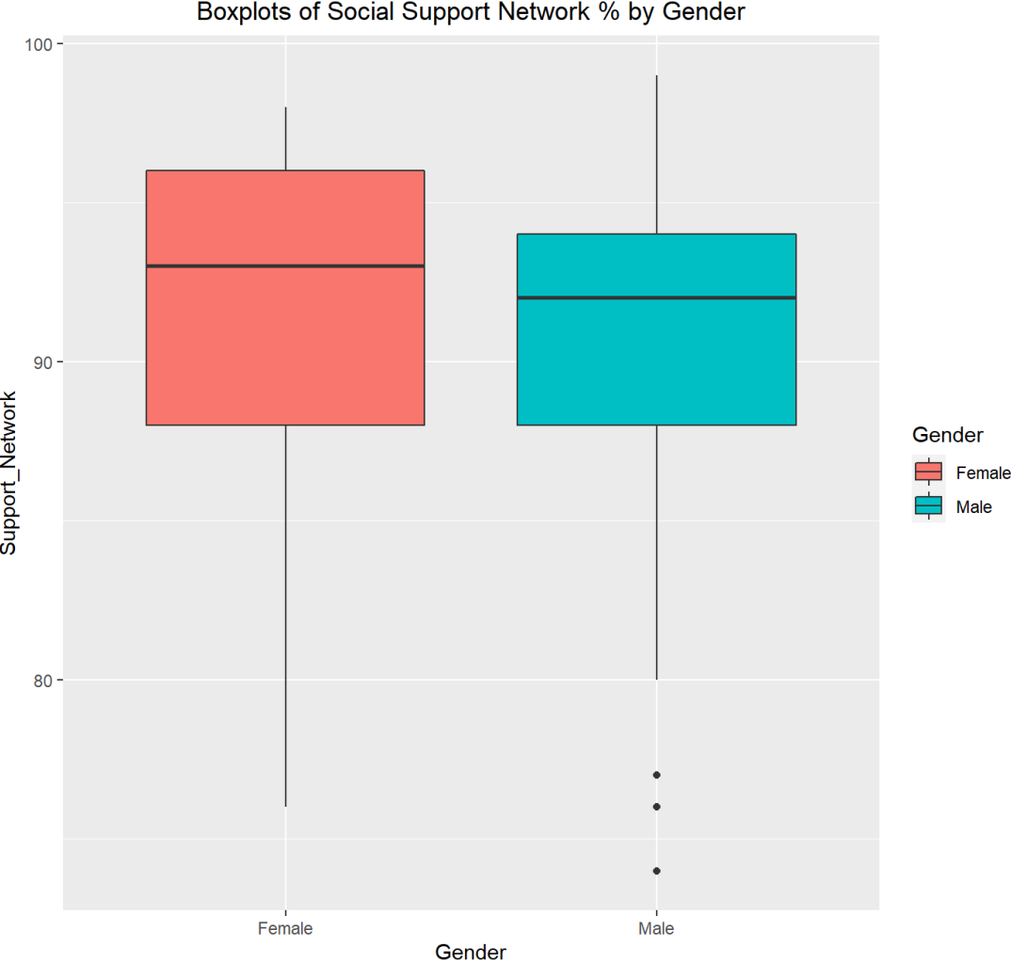
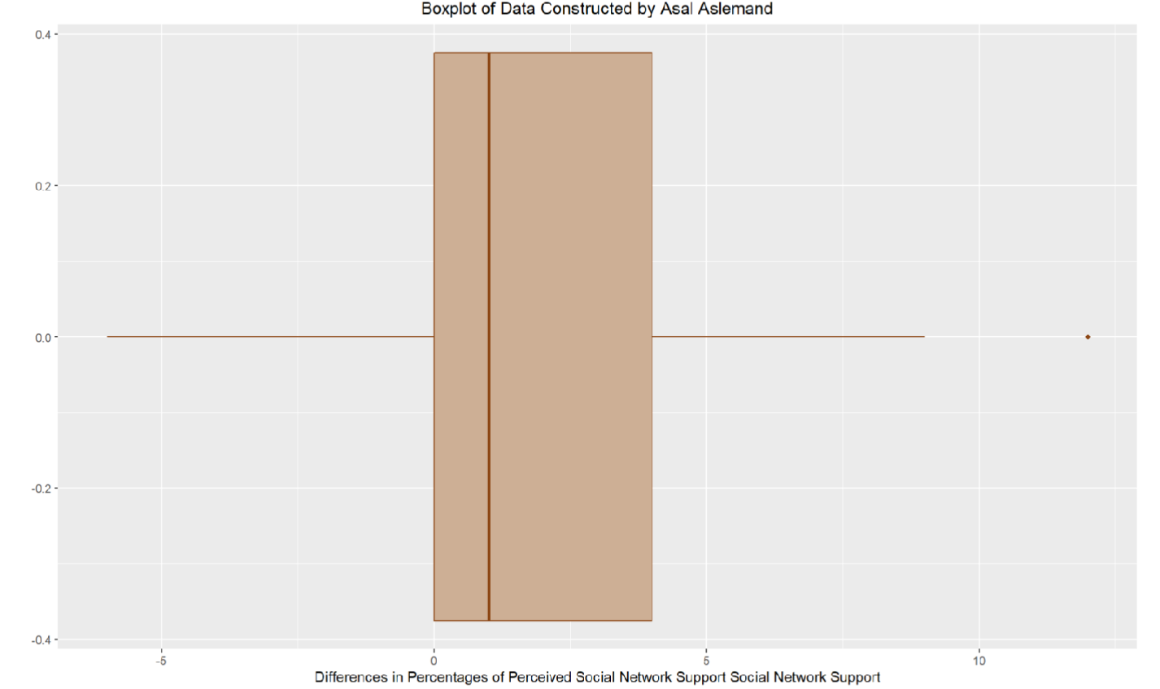
Statistical Results from Example 1

Slide 9
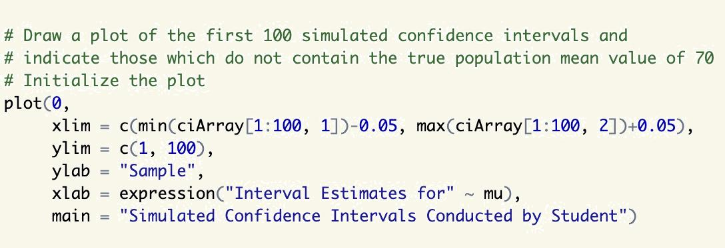
Students’ Reflections of the Activity
I needed familiarizing myself with the dataset and the R environment. That’s why I took some time to view the contents of the dataset as well as the script itself.
Because this activity was before the actual tutorial session, I could take as long or short as I wanted. The step-by-step instructions helped break down the process into manageable parts in times I was feeling on the fence.
By running the script line by line, I could understand the functions better.
Notes:
Grappling with the activity required familiarizing myself with the dataset and the R environment. That’s why I took some time to view the contents of the dataset as well as the script itself.
Because this activity was before the actual tutorial session, I could take as long or short as I wanted. The step-by-step instructions helped break down the process into manageable parts in times I was feeling on the fence.
By running the script line by line, I could observe the changes and understand the functions and their outputs to the best of my ability.

Slide 10
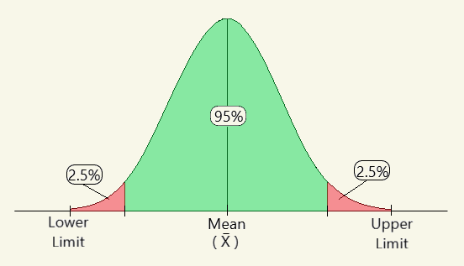
Example 2: Simulating Confidence Intervals
Simulating course grade data from STA123
with μ = 70, and σ = 5.
Generating data by doing 10000 simulations. to obtaining sample means and constructing. 95% confidence intervals.
Realizing that about 9500 of all samples will contain the true mean course grades and about 500 will not.
Visualizing the concept using 100 simulations.
Notes:
The main purpose of this pre-task tutorial activity was to obtain a 95% confidence interval for the grades of a course (STA123) using simulation in R-studio.
We supposed that STA123 course grades were Normally distributed.
Instead of collecting data from students, we simulated (generated) some data for our example.
To simulate data, we needed to know the population mean and standard deviation of STA123 course grades. Here we assumed the mean STA123 course grades is 70 and SD is 5.
Steps for carrying out the simulation: 1. Generate a set of STA123 course grades data with 150 students from the population
2. Calculate the observed sample mean of STA123 course grades and the standard error of the sample mean.
3. Calculate the confidence interval
4. Check whether the confidence interval contains the population parameter value
5. Repeat steps 1-4 10000 times and count the total number of times that the confidence intervals contain the population value.
6. For a 95% CI, one would expect about 9500 times the CIs contain the population value. image source: https://www.geeksforgeeks.org/confidence-interval/ https://digitalelearnings.com/confidence-interval/

Slide 11
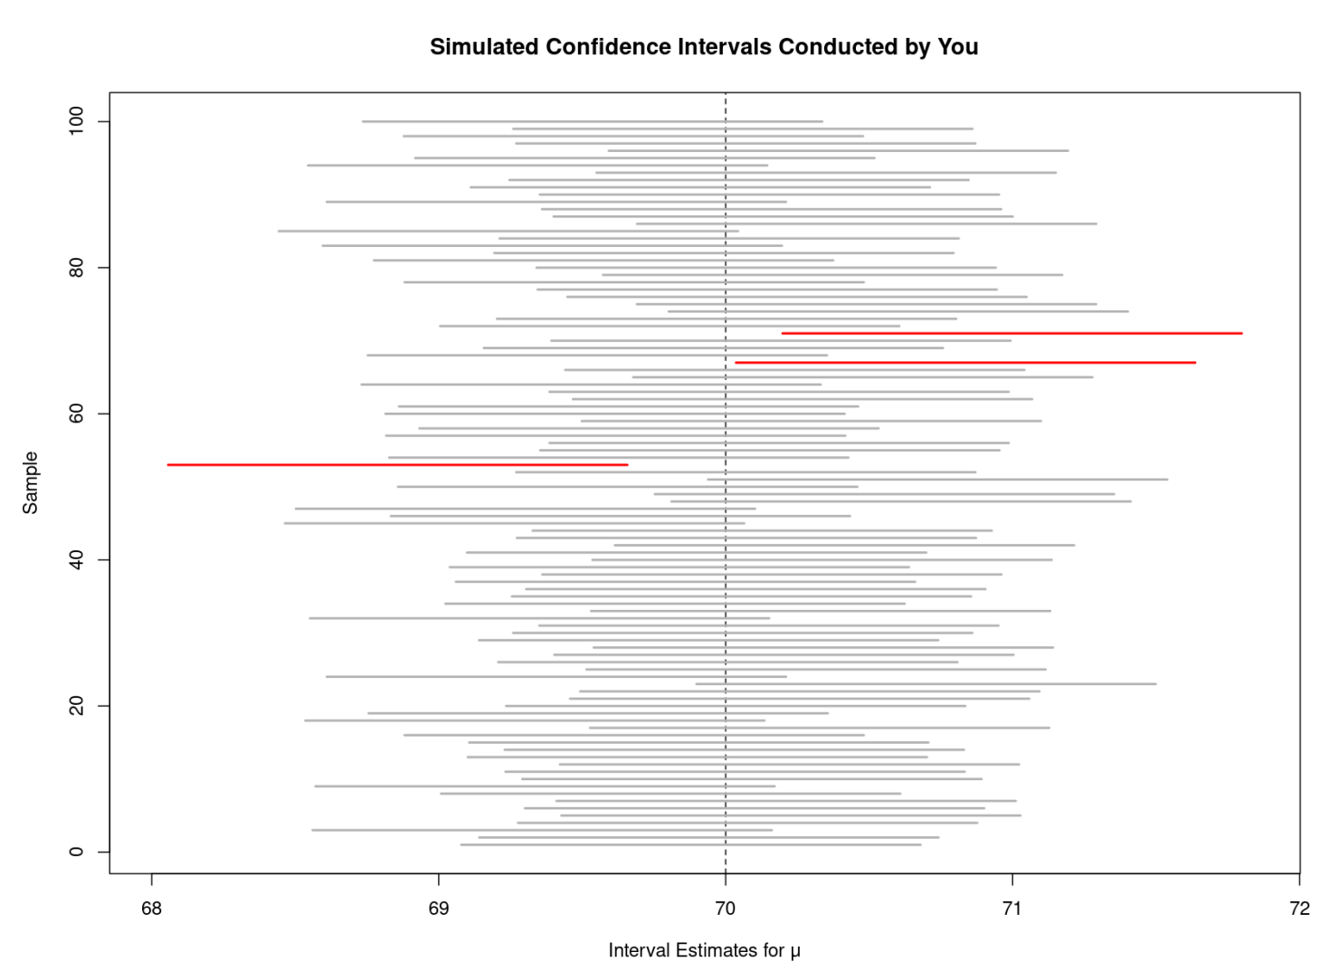
Statistical Results from Example 2

Slide 12
Students’ Reflections of the Activity
Since ever student used a different seed number, everyone’s results were unique. This was a great way to start conversation with our peers.
The R script generated a histogram, boxplot, as well as QQ plot. Looking at these plots helped me practice my visual analysis…
In-line comments clarified any confusion I had and helped me worry less about the process of conducting statistical analysis.
Visualizing the procedure for constructing confidence intervals showed that where this activity really went beyond numbers.
Notes:
Each student used a seed number which remained constant throughout the term so everyone’s results were unique. this was a great way to start conversation with other peers.
The R script generated a histogram, boxplot, as well as QQ plot. Looking at these plots one by one as they appeared on screen further helped me practice my visual analysis when it comes to defining what makes a normal distribution normal.
In-line comments clarified any confusion I had and helped me worry less about the process of conducting statistical analysis.
At the end of the activity, a visualization of how the confidence intervals given a value of alpha align with the mean. This part in my opinion is where this activity really went beyond numbers.

Slide 13
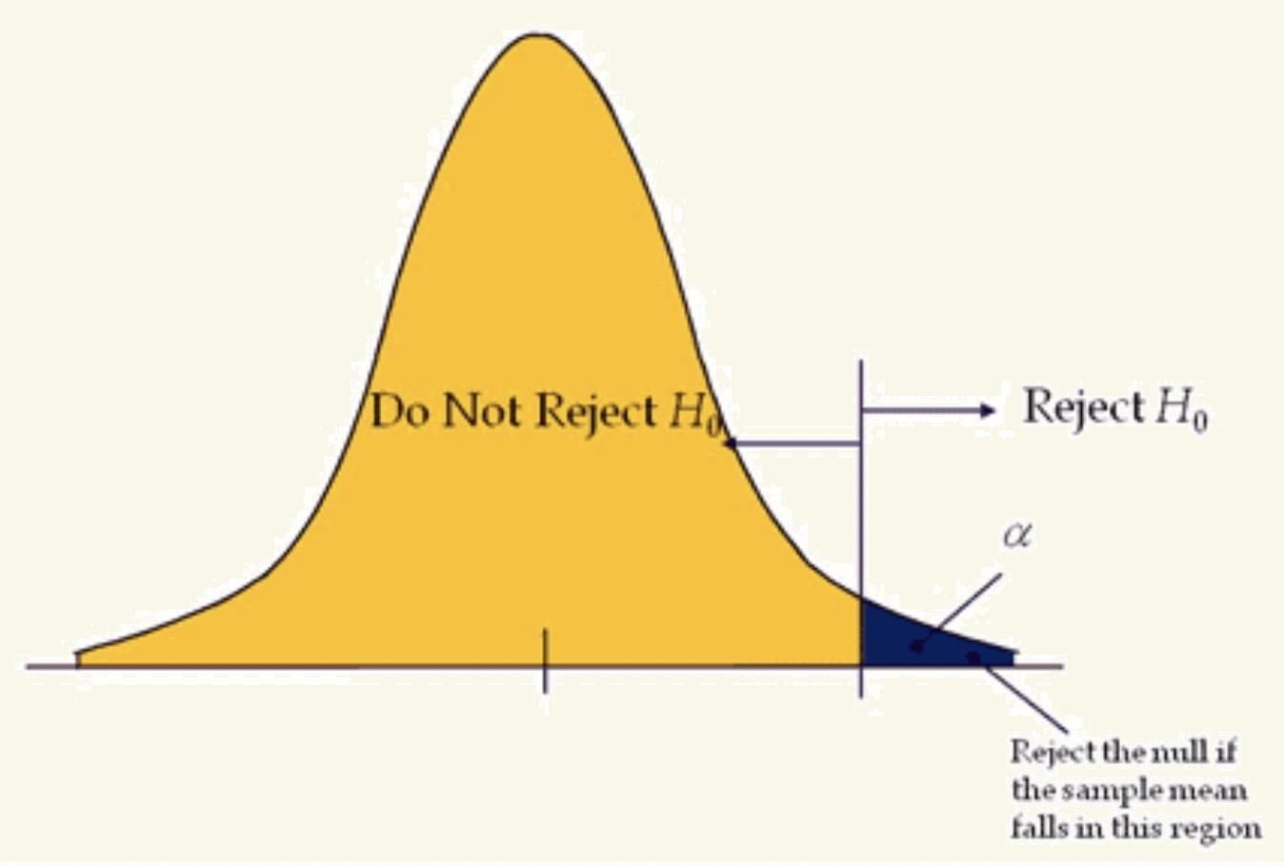
Example 3: Hypothesis Testing Error Simulation in R
Simulating course grade data from STA123
with μ = 70, and σ = 5.
Testing H₀: μ = 70, H_{a}: μ > 70 , 𝛼 = 0.05 in R-Studio.
Generating 10,000 samples of size 25, finding their test statistics and finding how many of those have p-value less than or equal to 0.05
Making a histogram of the observed test statistics..
Notes:
Before class we used R to simulate 10,000 random samples of size 25 from a Normal population with given parameters and we used R to do 10,000 t tests for each of the random samples and store the test statistics.
We used R to count the number of test statistics that had a p-value less than or equal to 0.05 and found that approximately 5% of the test statistics had a p-value of less than or equal to 0.05.
We also used R to model a histogram representing all the t-statistics and showing which ones have p values less than or equal to 0.05.
Suppose STA123 course grades are Normally distributed with mean 70 and SD of 5.
Estimate the error probability in a t-test of Ho: 𝜇 = 70 verses Ha: 𝜇 > 70 when the underlying population is Normal with 𝜇 = 70 and 𝜎 = 5. Take a random sample of n = 25 and test at 𝛼 = 0.05
Using the STA123 course grades example, we can conduct an experiment using the following steps:
Generate a set of (10000) STA123 course grades data with 25 students from the population.
For each of the generated random sample, conduct a t test.
Store the observed t test statistics and the p.values in matrix
Count the number of p.values that are <= 0.05 (𝛼-level) to estimate the probability of error

Slide 14
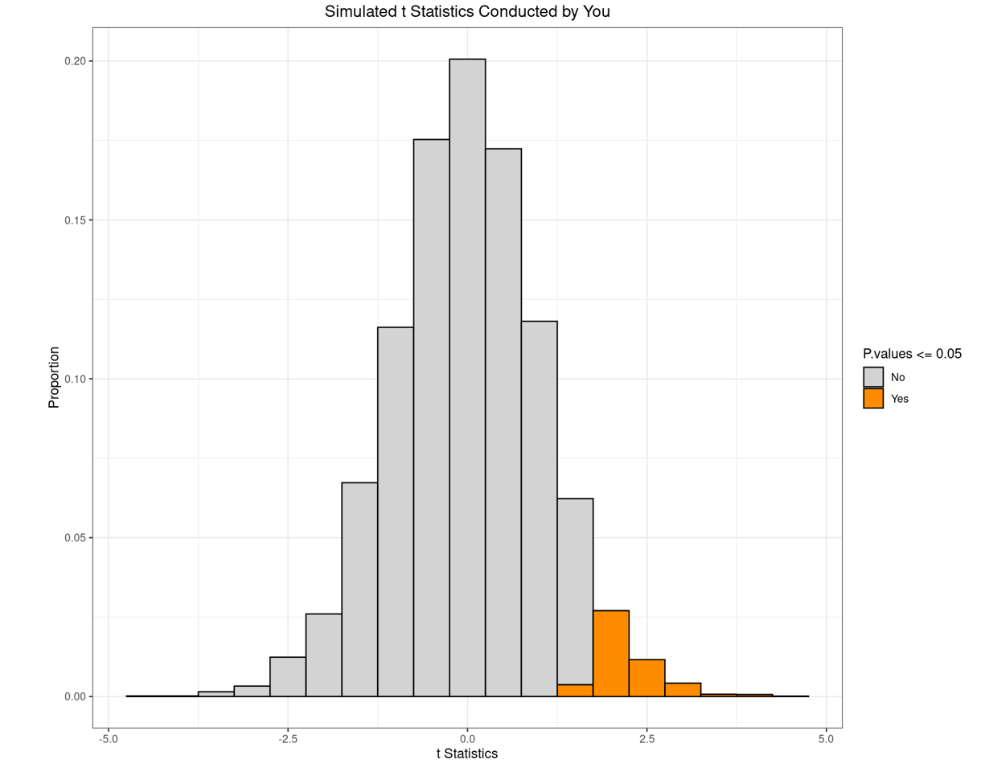
Statistical Results from Example 3

Slide 15
Reflection of the Activity
Making the histogram and actually putting it together with the script that we run through R made it clear how the test statistics with small p-values made up the extreme values of the test statistics.
By calculating the proportion of test-statistics that are less than or equal to 0.05 I learned that an error of 5% is saying that if the null hypothesis is true, about 5% of all samples (of size 25 in our case) will result in extreme test-statistic values with p-value of less than or equal to 0.05.
The connection between level of significance and p-values was made clearer. I’d seen hypothesis testing in previous courses, but in addition to doing some hypothesis testing, actually running a simulation in R makes the concepts of p-value and error probability clearer than simply doing a hypothesis test would.

Slide 16
Overall Observations from Students’ POV
Making weekly activities a fair portion of our grade ensured attendance and helped us keep on track.
Pre-tutorial activities gave us a chance to use R and actively do statistics.
Pre-tutorial activities didn’t require extensive R knowledge, the scripts were given to us with helpful comments to explain the code because the code itself can be confusing sometimes. By still asking us for some input in the code, it made sure that we’re reading through it so that we have proper understanding of the activity.
Releasing the questions ahead of tutorial session allowed us to feel more prepared and allowed us to think about them in advance which made it less stressful.
Posting solutions afterward ensures clarity even if we struggle with the material during the tutorial; we’re able to see where we went wrong and fix our understanding and misconceptions of the material.
Notes:
Making it such a large portion of our grades ensured basically everyone always showed up to tutorials which helped keep us on track
Pre-tutorial activities gave us a chance to use R and actually, actively do statistics as opposed to just listening to a lecture.
Pre-tutorial activities were also good because they didn’t require extensive R knowledge, the scripts were given to us so we are able to follow along, especially with helpful comments to explain what the code is doing because the code itself can be confusing sometimes. By still asking us for some input in the code, it makes sure that we’re reading through the R code to ensure we have some understanding of the activity.
Because the tutorials sometimes feel like quizzes, they can be stressful at times, but releasing the questions ahead of time allowed us to feel more prepared, to think about them in advance, and being able to ask our TA for assistance was also helpful.
Solutions being posted ensures even if we struggle with the material in tutorial, we’re able to see where we went wrong and fix it.

Slide 17
Observations from Teaching Assistants’ POV
Students formed study group in small groups. When encountering difficulty, they would first ask their group members for help, then check lecture slides or the internet, and finally come to the teaching team for verification.
Students often sought confirmation on their understanding about the tutorial activities such as how to check for normality, interpretation of confidence intervals, and specific derivations.
Students willingly asked for a chance to tackle problems on their own. After that, we would write the relevant formulas, theorems, and definitions needed to complete the tutorial activities.
Students often preferred answers that guide them rather than direct solutions. This encouraged them to go through the steps and think about what they are working on.

Slide 18
Takeaways
Weekly tutorial activities will:
Be stimulating, less stressful, and incentivizing.
Encourage ongoing student engagement with the course material.
Allow students collaborate with their peers and their teaching assistants.
Foster students’ confidence in gaining statistical skills.
Notes:
Based on the course evaluation, students found weekly tutorials stimulating and engaging, providing them with a deeper understanding of statistical concepts and opportunities to demonstrate an understanding of the course material in an atmosphere that was conducive to their learning. They were encouraged to keep up with their studies on a weekly basis in a less stressful way. This teaching and learning strategy can be incorporated into any statistics course at the tertiary level provided that the course has practical sessions (size of about 40 students) to enable students to work in small groups (about 5 students per group).
Goals (Updated) We would like the eCOTS participants to take away from this presentation that incorporating weekly relevant statistical activities into applied statistics courses for students to work on will support their learning. Students are encouraged to keep up with the course material on an ongoing basis. They can work on the weekly activities with their peers and their teaching assistants, ask questions, and clarify any misconceptions in a friendly environment, and in turn develop confidence in doing statistics.

Slide 19
Thank You ☺

