Slide 1
Exploring Normal Distributions with Water Quality Data
Texas State University
Amanda Walker & Leslie Shroyer
ECOTS 2024

Slide 2
The Meadows Center for Water and the Environment
The Meadows Center is a component of Texas State University. It is located on an environmentally protected area, Spring Lake feeding from the Edwards Aquafer, the headwaters for the San Marcos River. The river runs through the east side of TXST campus.
In 2013 the Center started collecting data
In 2022 the Center received a grant of approximately $ 2.5 million to study the impact of climate change.
Data Set:
https://www.meadowscenter.txst.edu/leadership/texasstreamteam/trainings-programs/standardcore.html

Slide 3
Classroom Environment
This activity is completed in an Elementary Statistics course in a computer room, so students have access to the web-based program Rguroo. Class size is roughly 30 – 50 students. Students can work independently or in small groups. Instructor at first leads the activity and then give students the opportunity to explore on their own. The activity takes roughly one 80 minute class to complete.

Slide 4
Rguroo Set Up
Rguroo: free account given to educaters
https://rguroo.com/teaching/
Account can be created in minutes
Easily import data set into the program

Slide 5
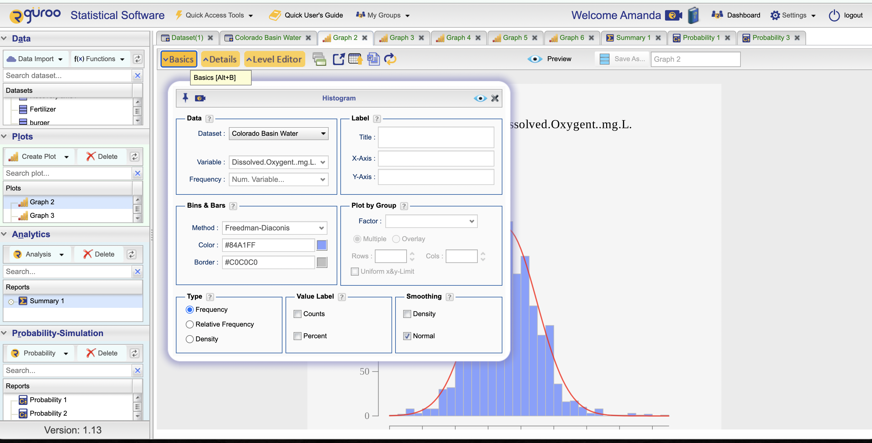
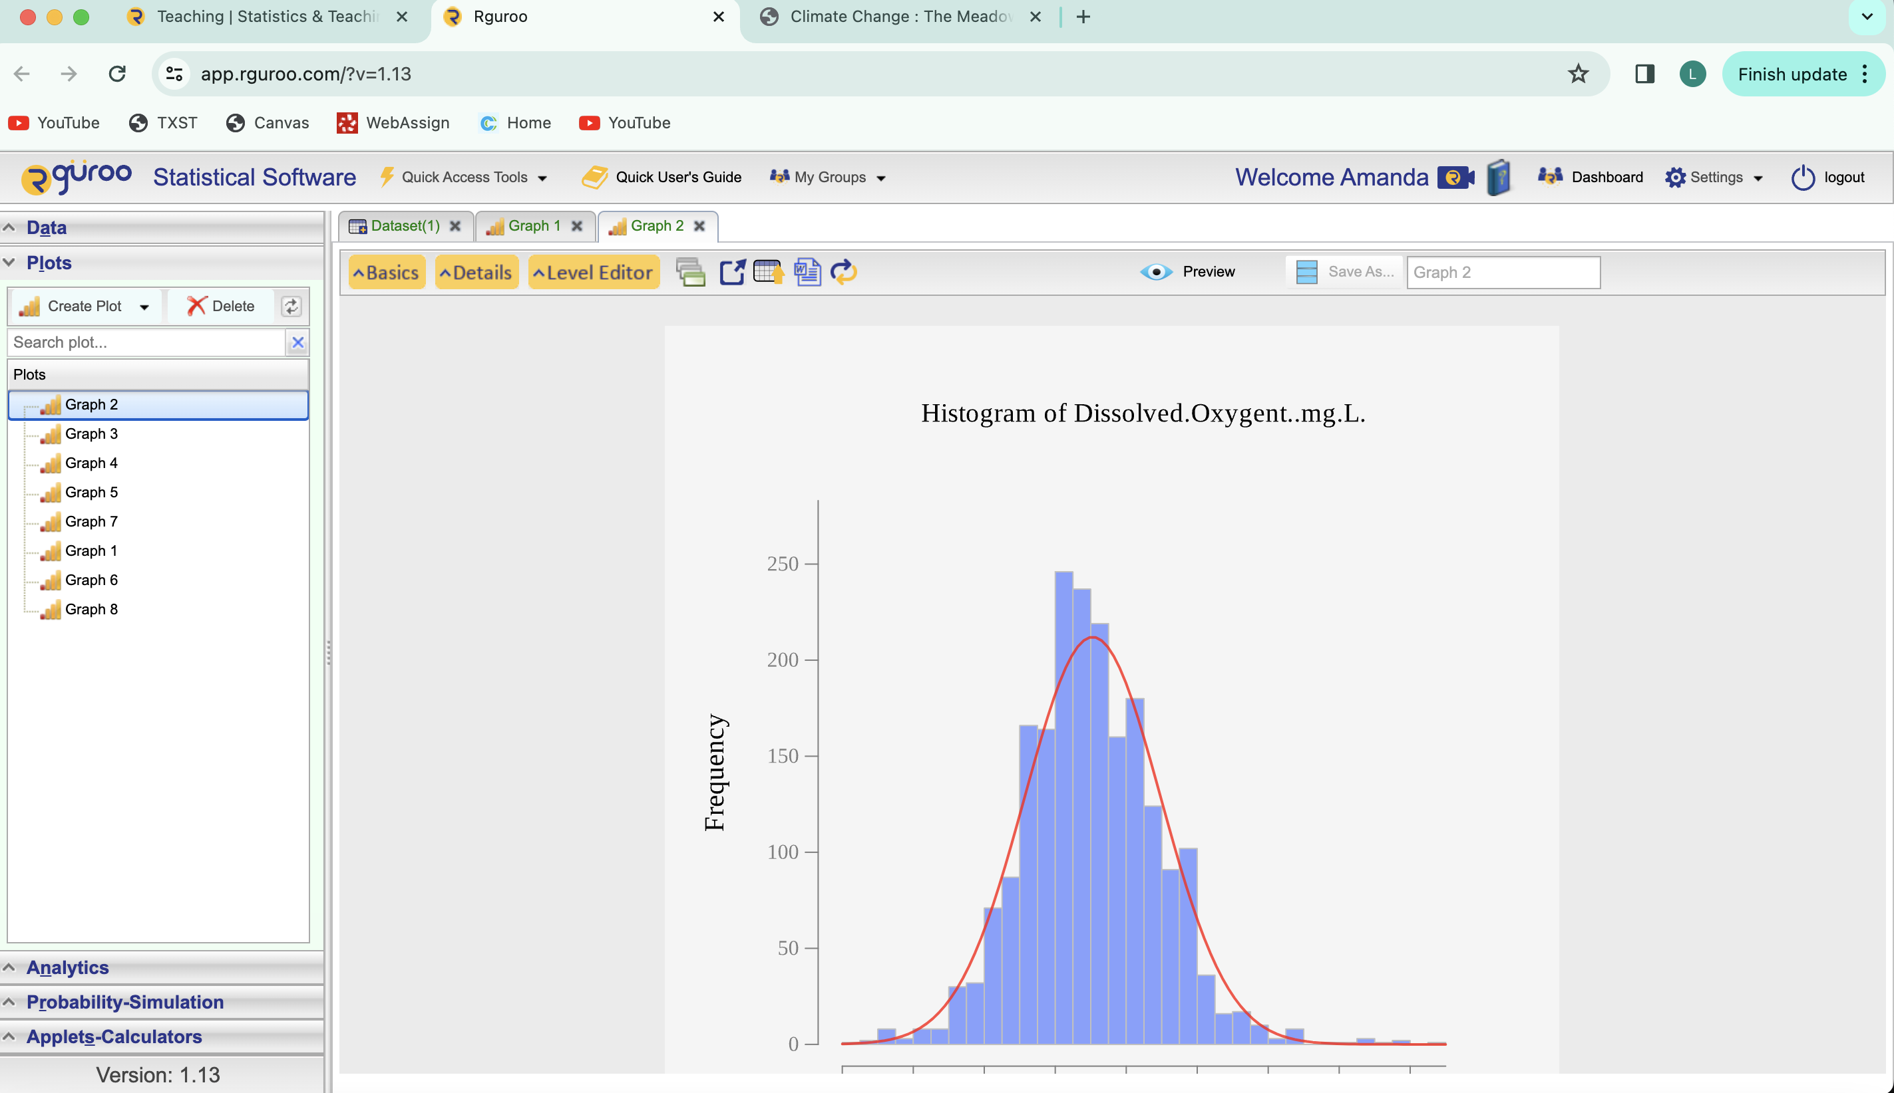
Exploring Which curves are Normal
Create Plots of Histograms to explore the distribution of variables

Slide 6
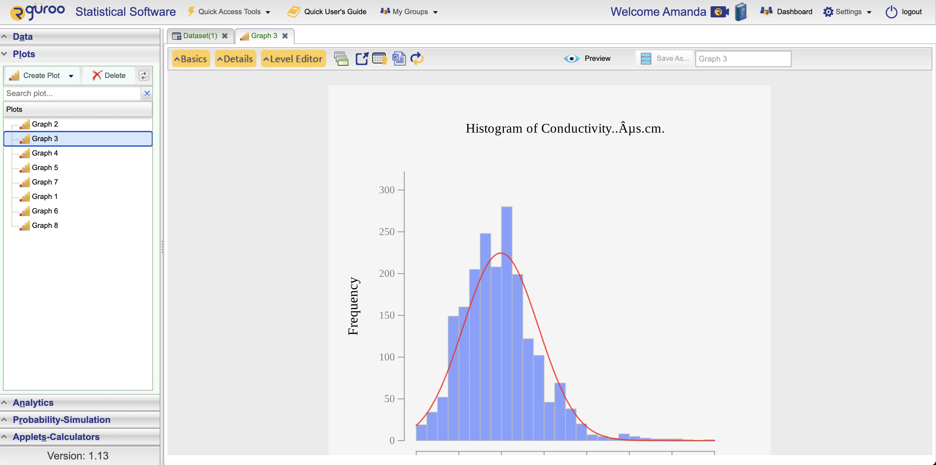
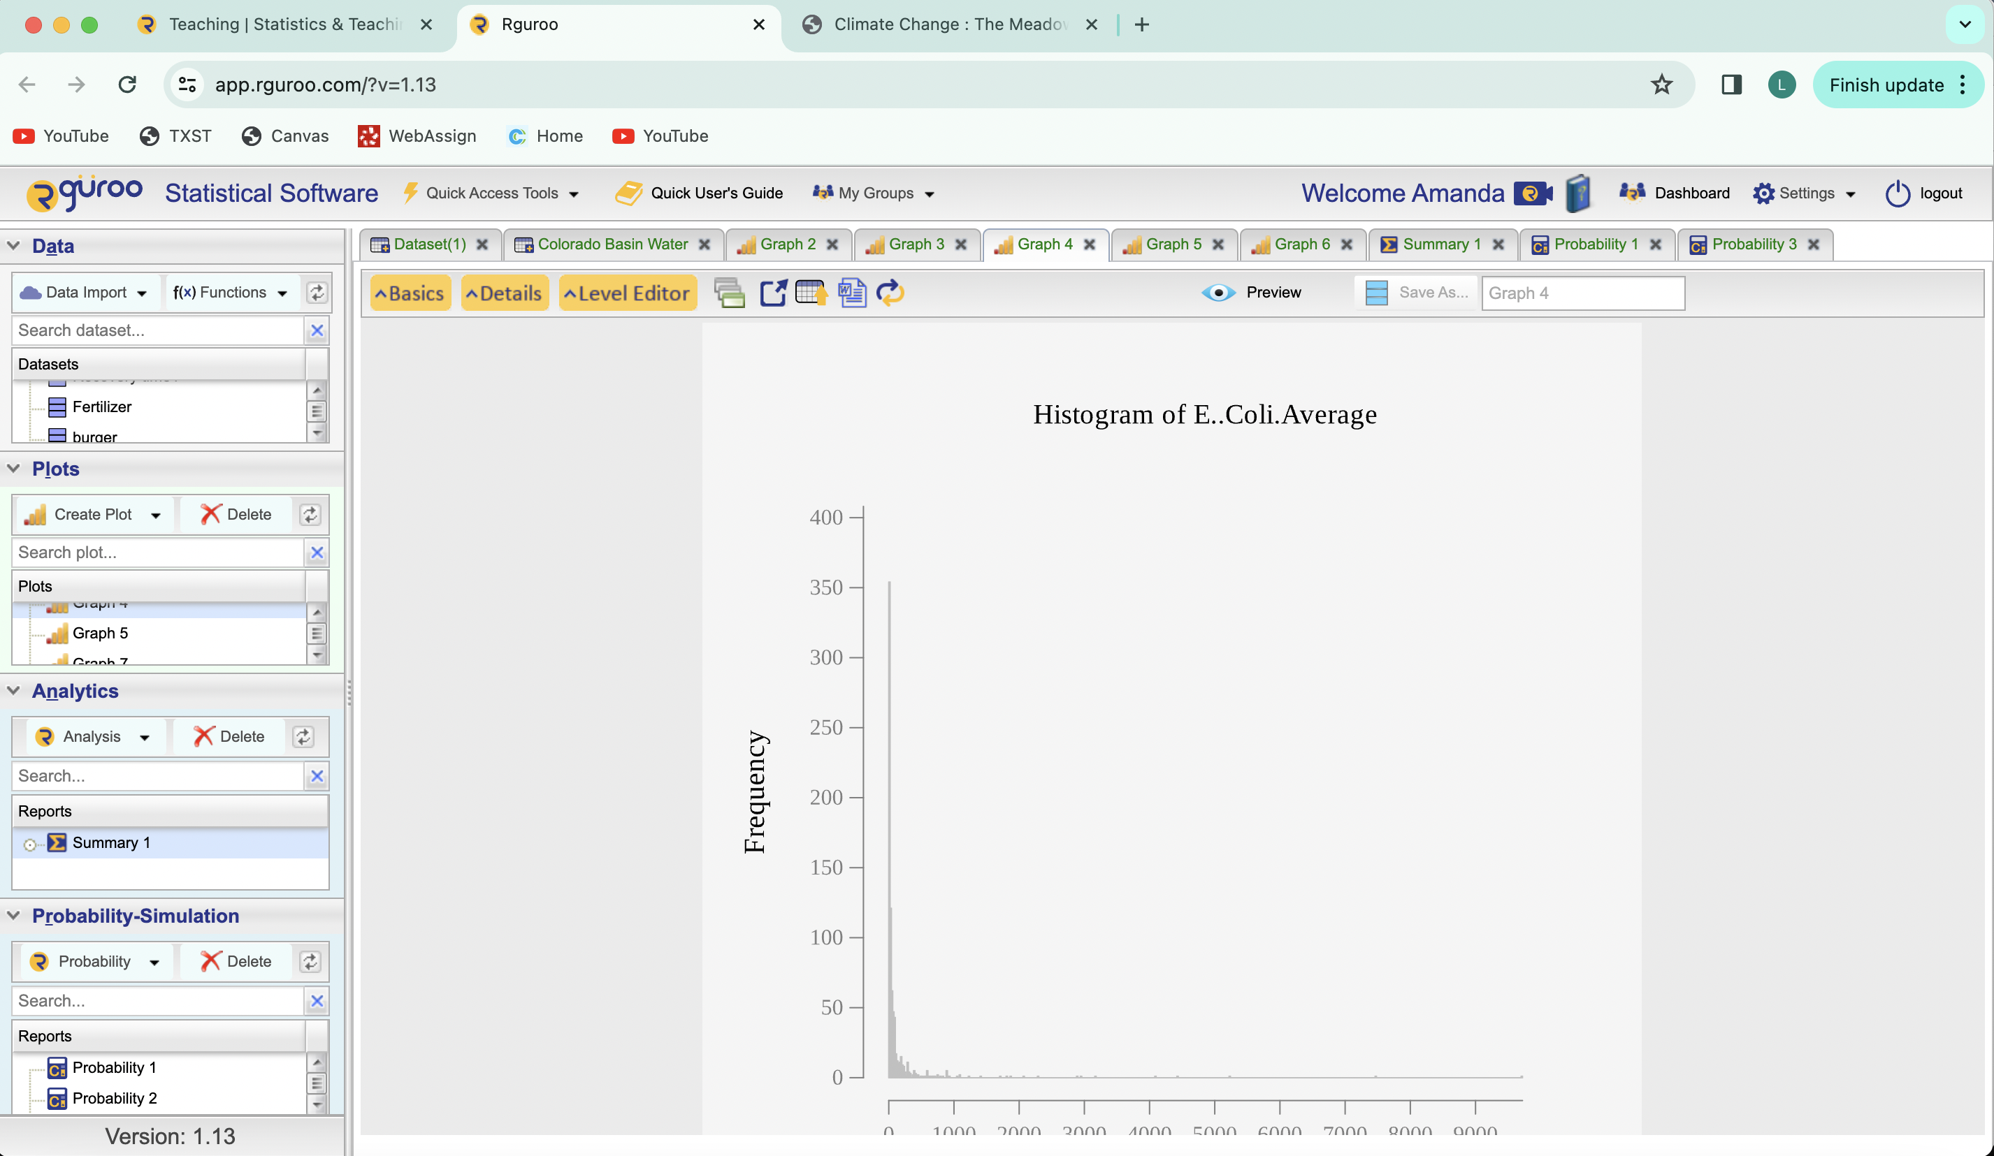
Graphs
Note: you can tell the program to display a normal curve line or not. Allows for better visual understanding.
The ability to see the different attributes side by side can open discussions on if it is normal or not.

Slide 7
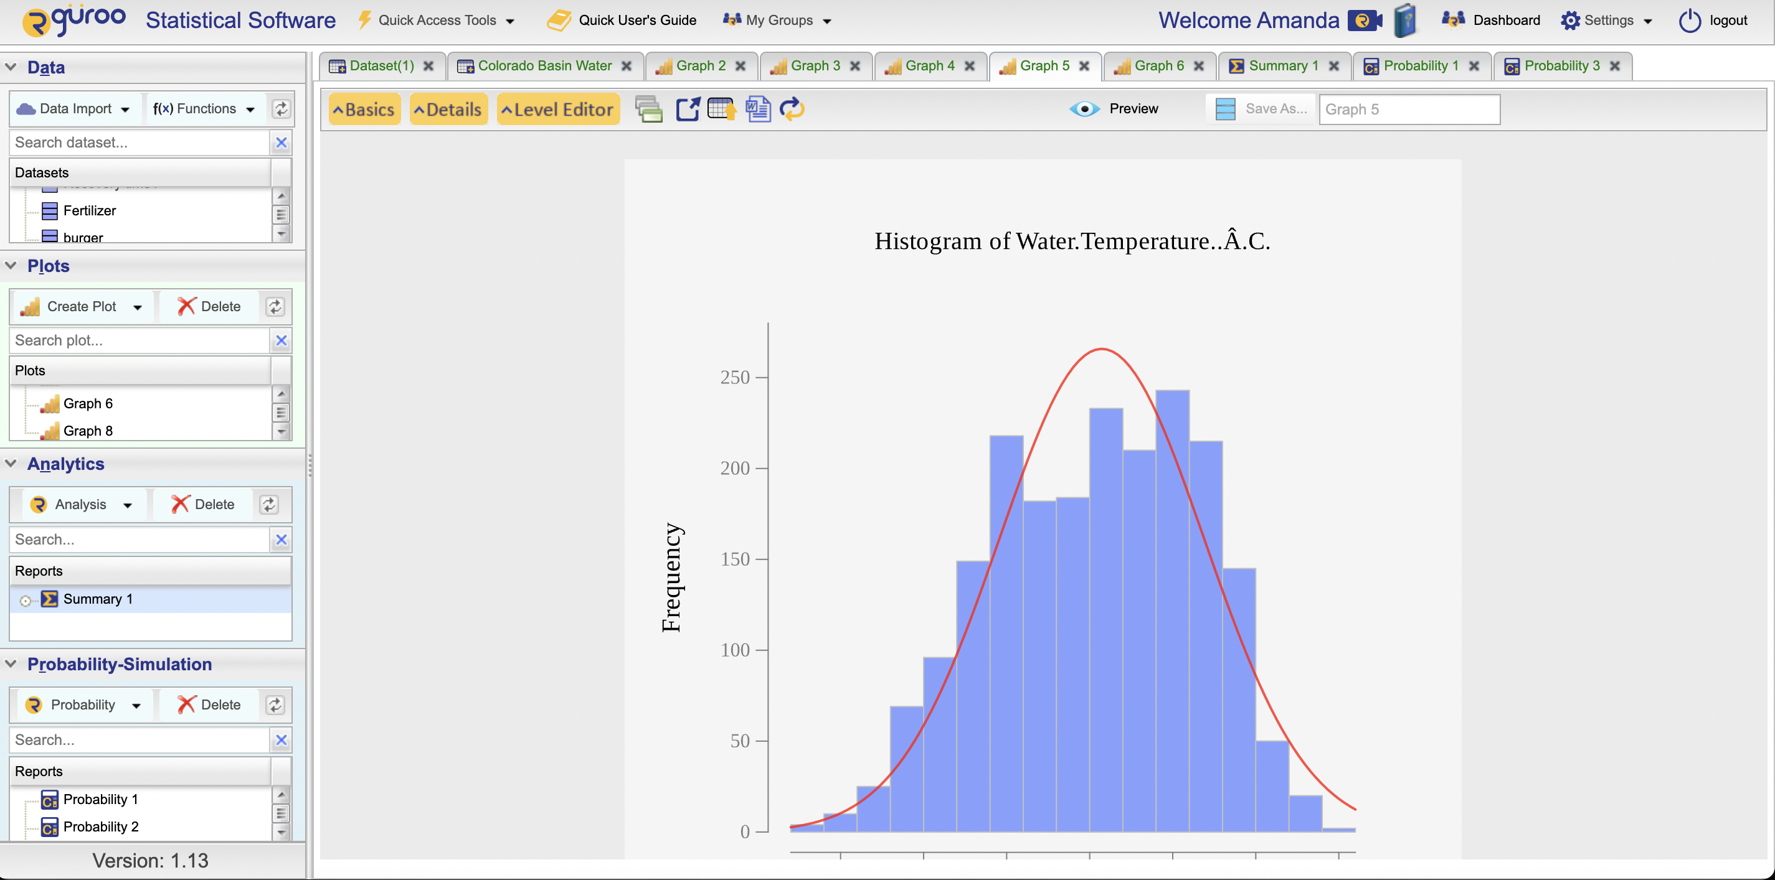
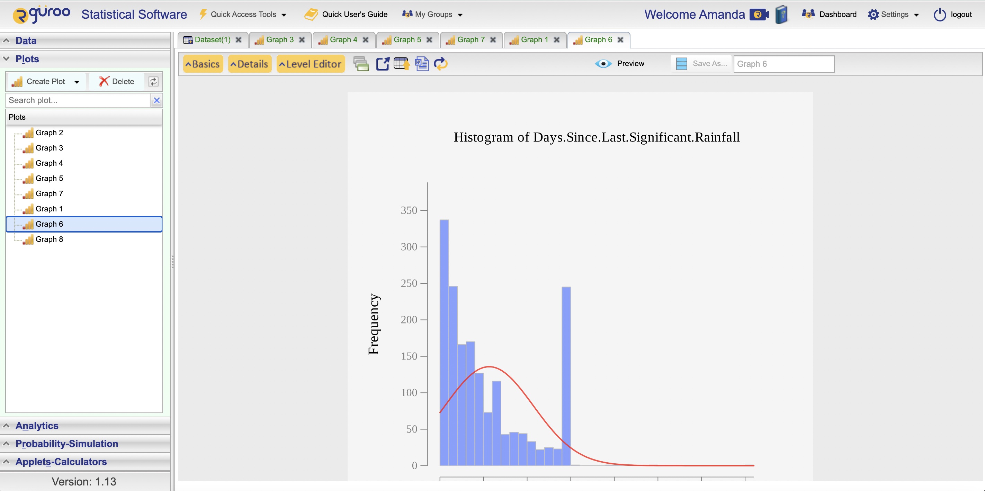
Graphs

Slide 8
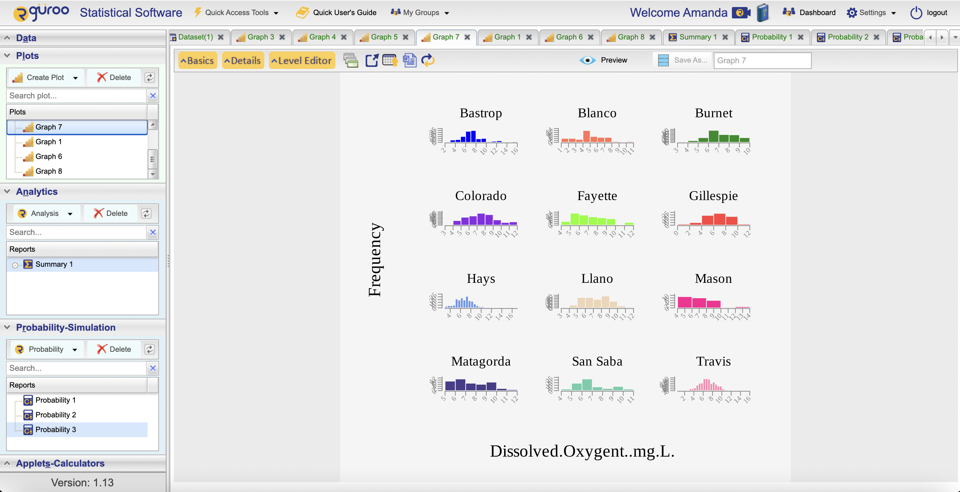
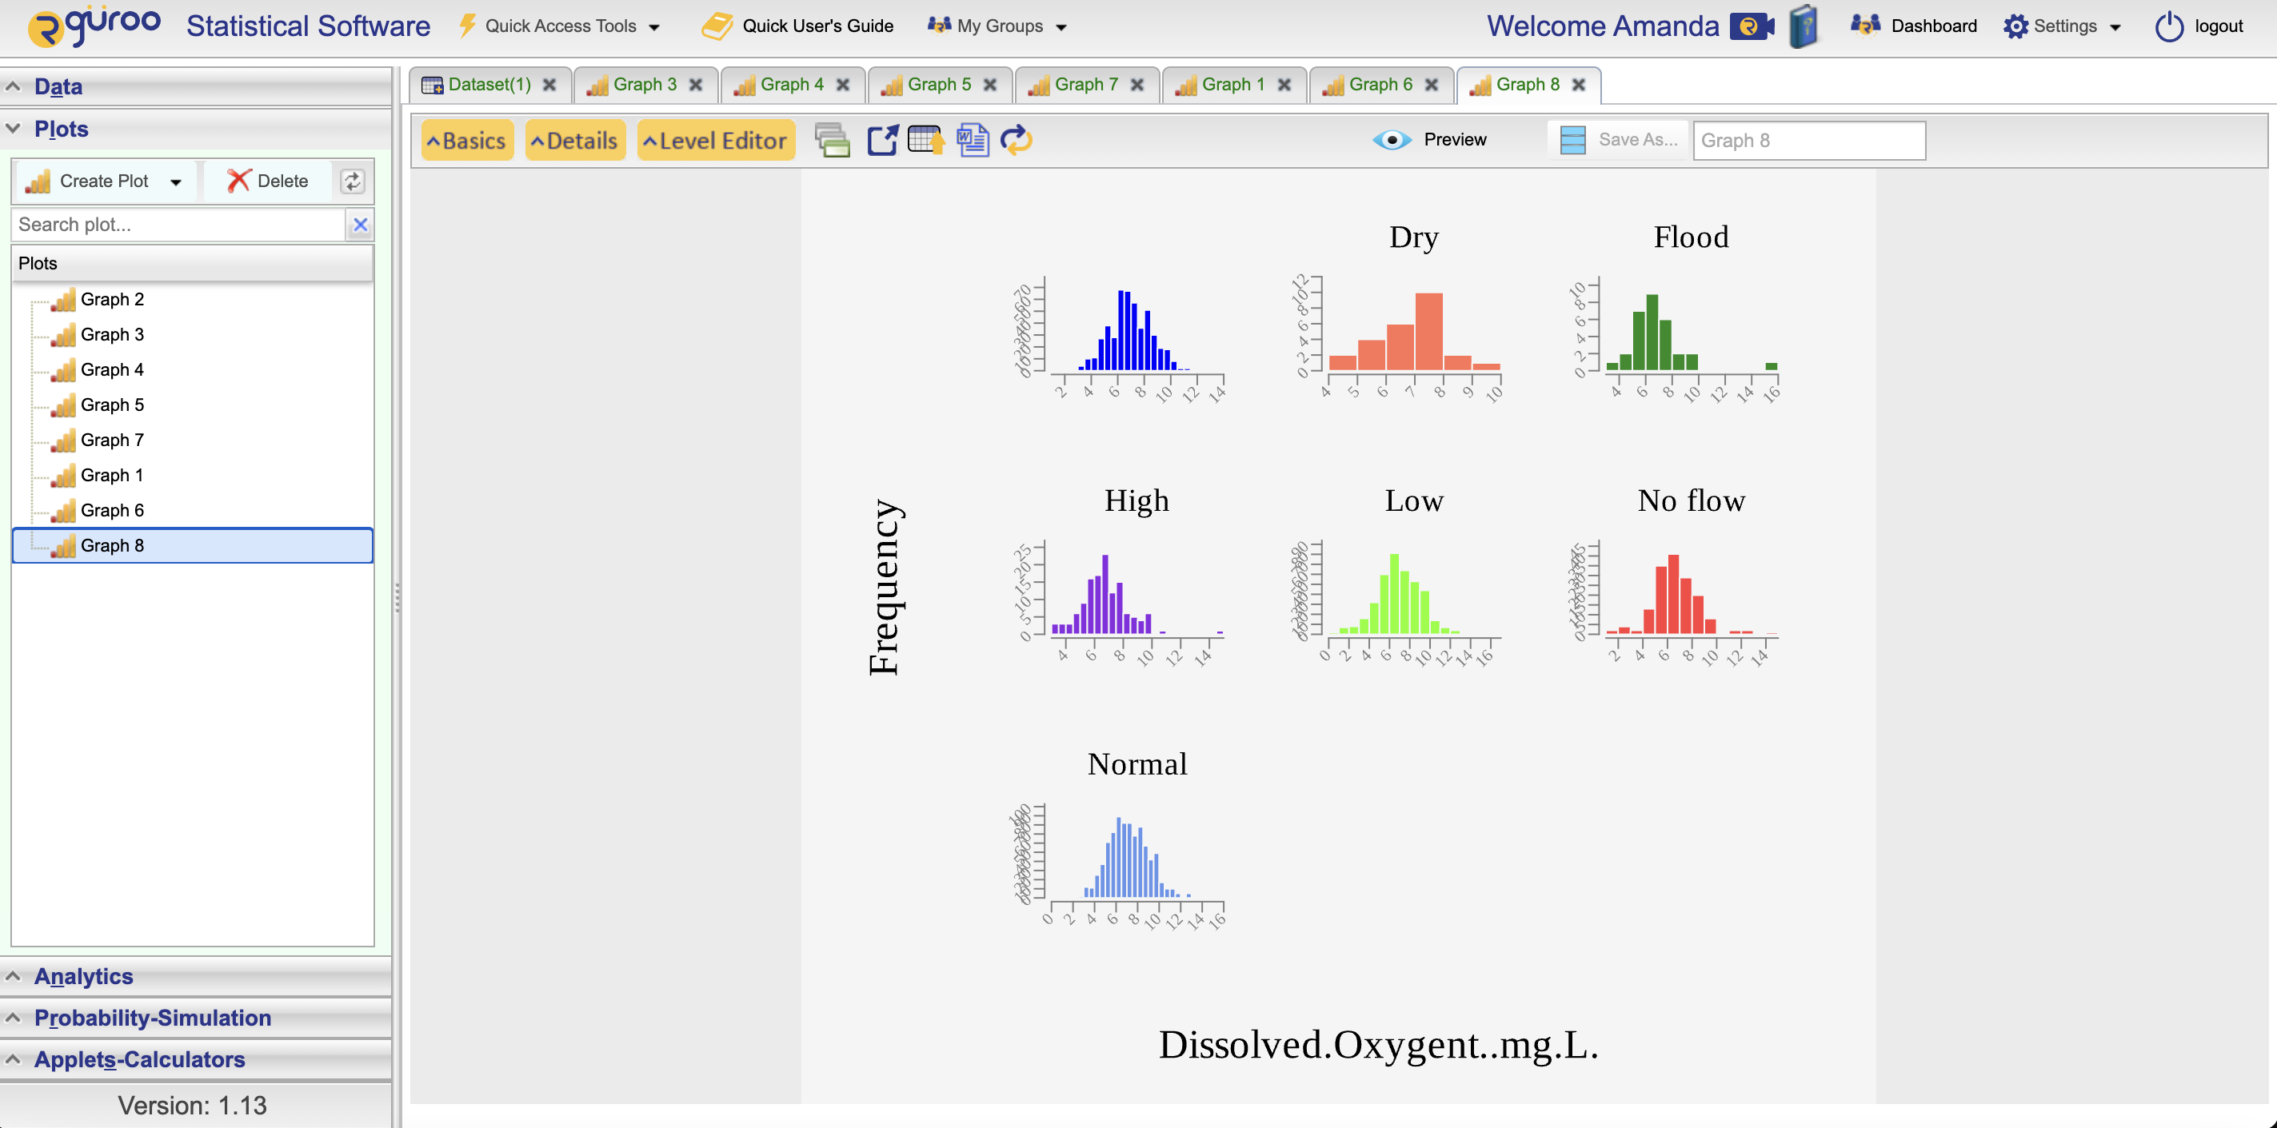
Graphs
Rguroo allows for the data to be factored by county or flow severity. Students can compare the spread and center.

Slide 9
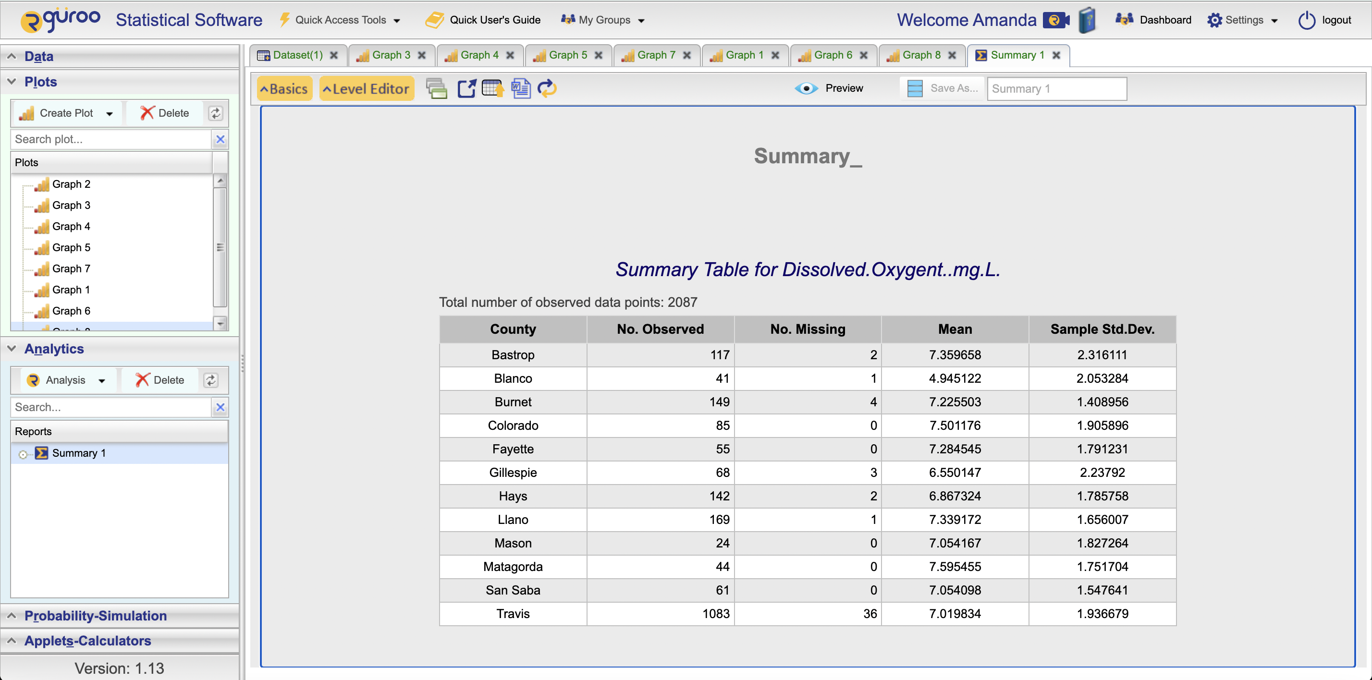
Analytics
Rguroo can pull up the analytics by county for any of the variables. Great for group discussions
on what the different means could signify and variance.

Slide 10
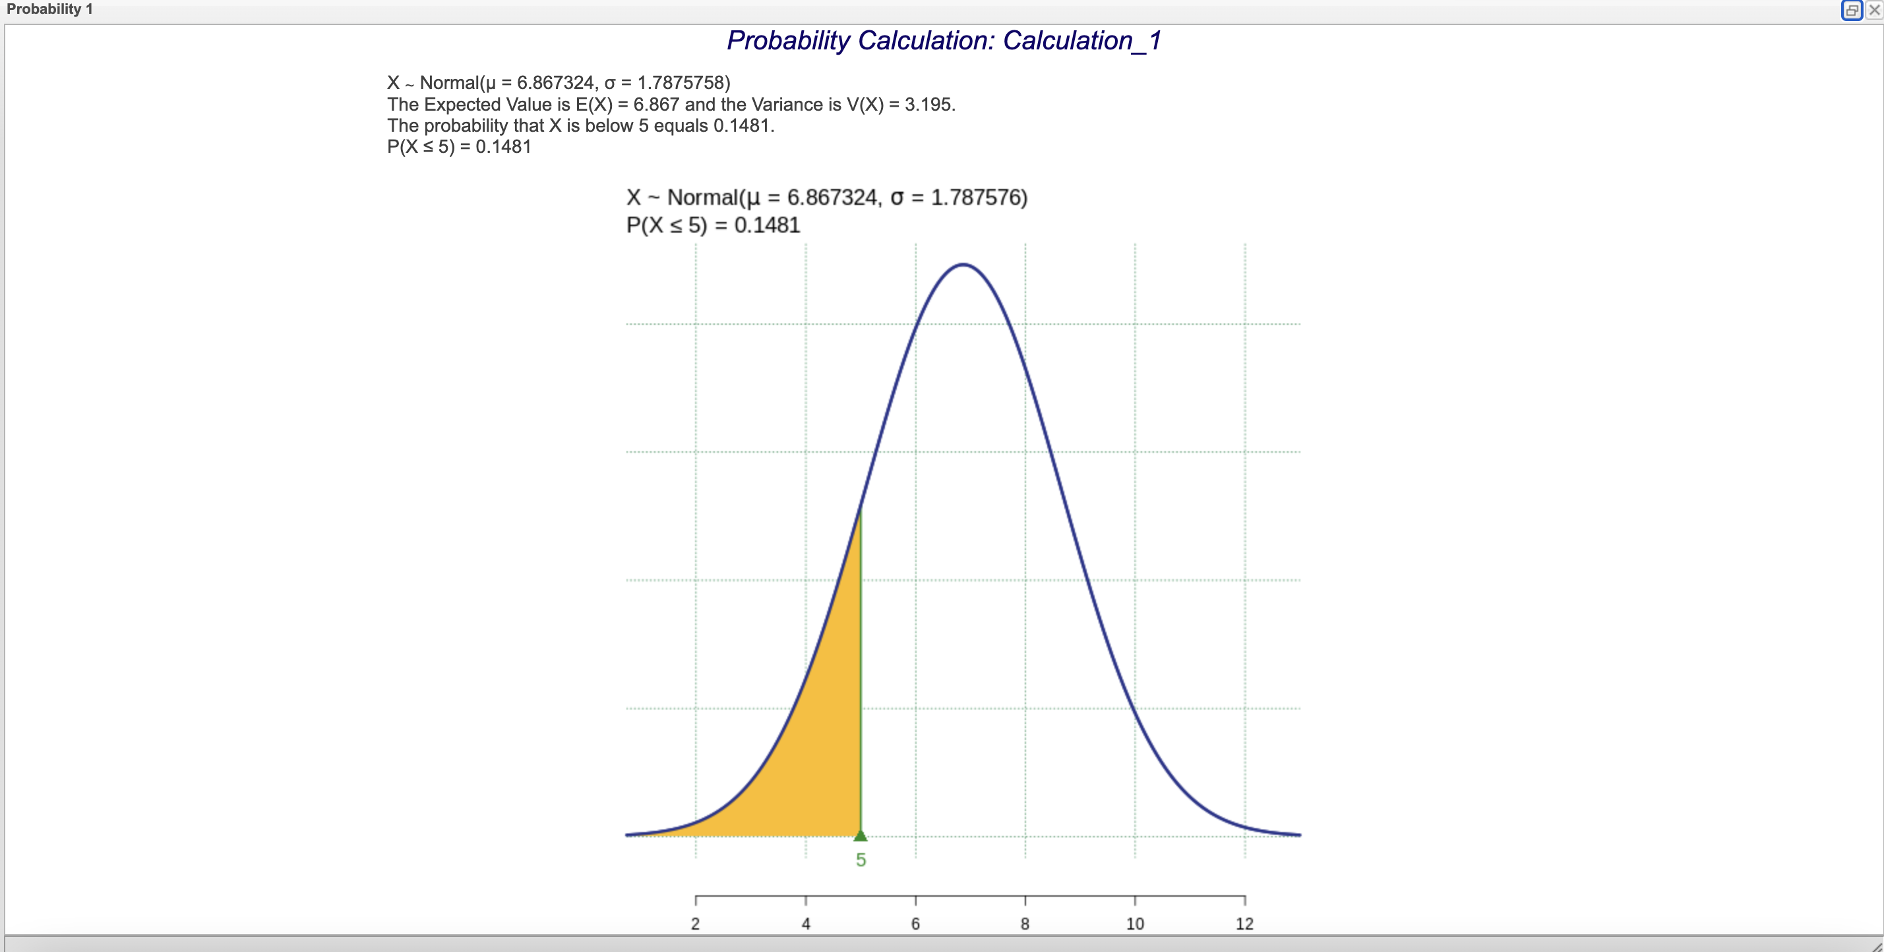
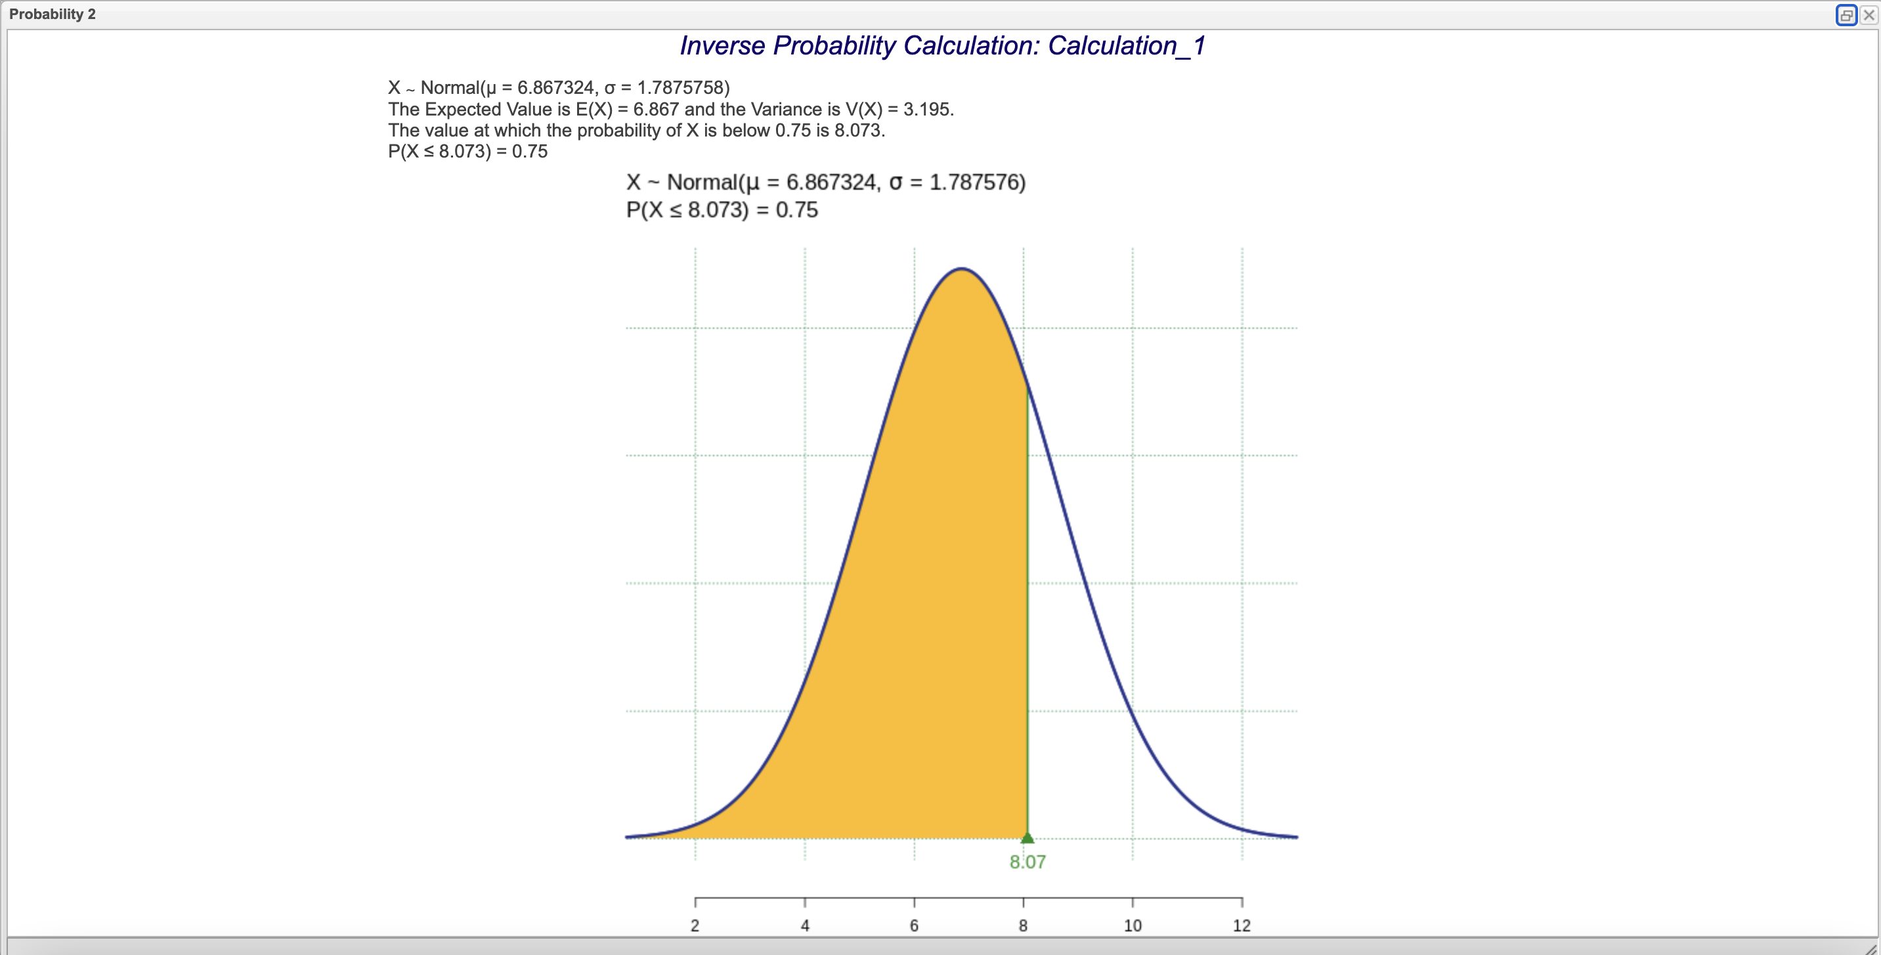
Probability Calculation
The activity asks students to find probabilities using Rguroo instead of the the Z-Table. One example shown by the instructor may be needed and then students can find requested information on their own. We explore Dissolved Oxygen levels together, then have students explore other variables.

Slide 11
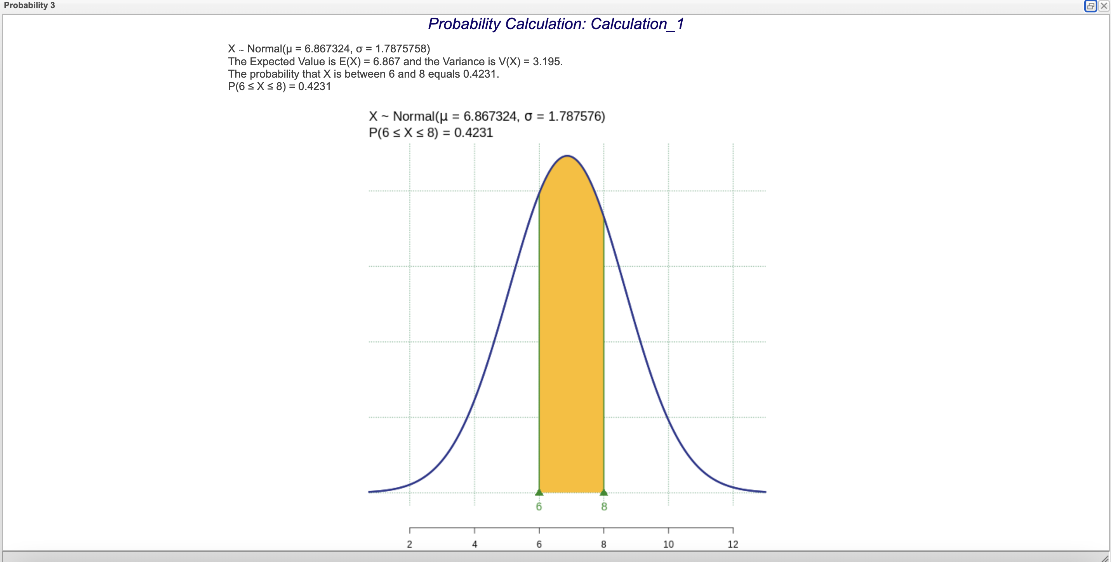
Probability Calculation
Students can find probabilities by typing in what parameters they want measured.This activity shows students that the z-table is not the only way to find probabilities. More time/emphasis can be spent on the interpretation of the probabilities.

