Slide 1

TigerStat
ECOTS 2014

Slide 2

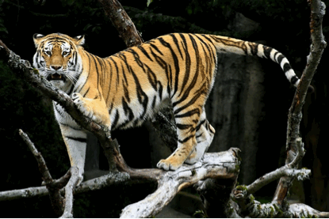
Real World Problem
Understanding the population of rare and endangered Amur tigers in Siberia. [Gerow et al. (2006)]
Estimating the Age distribution of the population is important to ensure sustainability

Slide 3
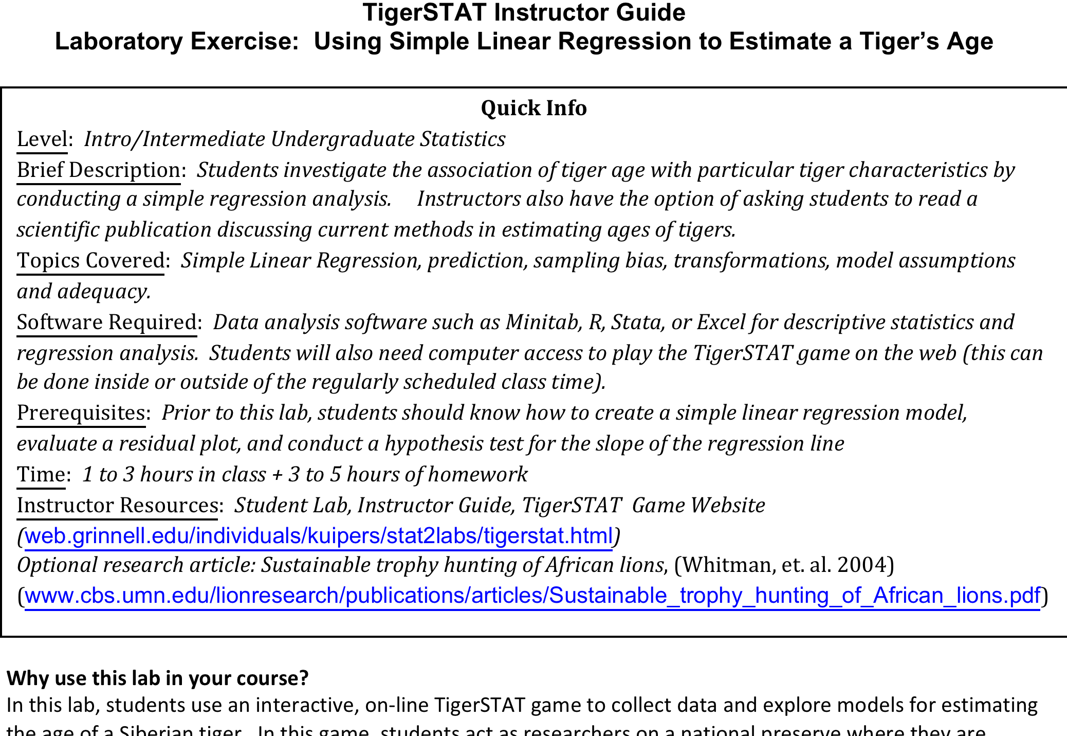
Lab Materials

Slide 4
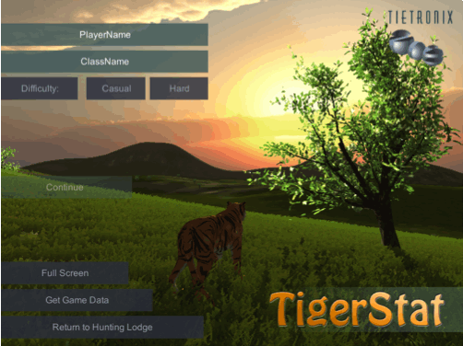
  http://statgames.tietronix.com/TigerSTAT/
PLAYING THE GAME
NOTE: NO TIGERS are hurt in the playing of this game

Slide 5
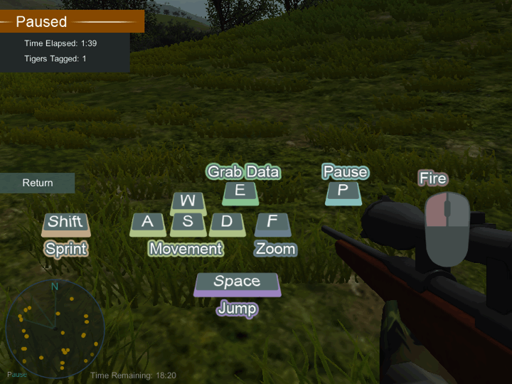

Slide 6
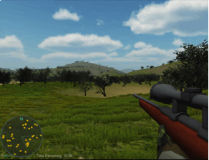
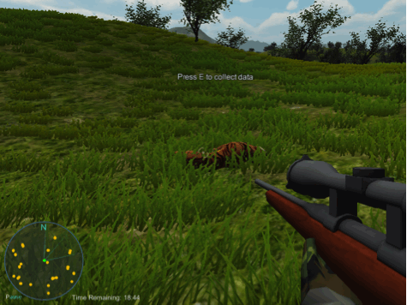

Slide 7
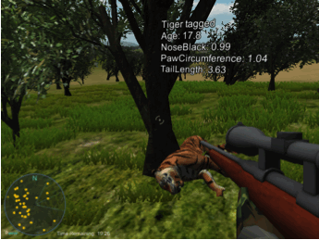
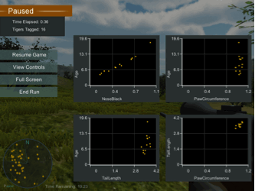
DURING GAME PLAY encourages thinking about the sample size encourages considering representativeness
DATA COLLECTED UPDATES

Slide 8
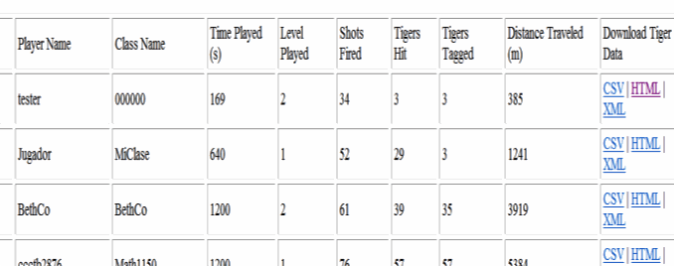

Slide 9
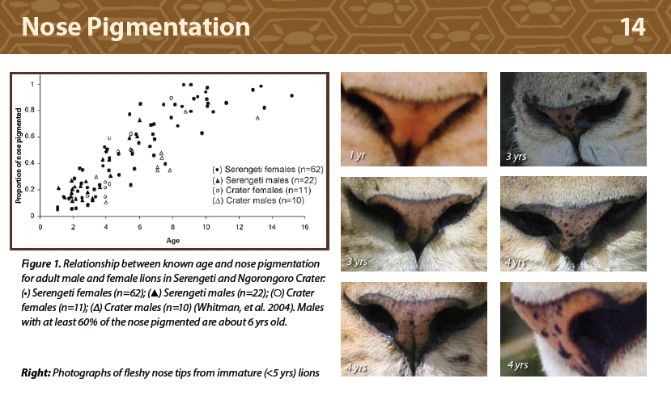
Literature review
Article from NATURE
How to estimate age of LIONS
Similar issue – how to ensure a sustainable population of lions

Slide 10
Research question and plan
Do techniques for estimating lion age apply to tigers?
To collect a sample and test model what issues must be considered?
How many tigers to sample? What data should we collect? How do we use our data to answer the question?
Lion model
Percentage of black on the nose
(Sample of 63 females)

Slide 11
Looking at the data
Plot variables against AGE
  What appears to be the best predictor?
Produce a simple regression model for AGE
  Is the predictor significant?
  What is the estimated coefficient?

Slide 12
Looking at the SLOPE
How much variability are there in estimated slopes? How much does this matter?
Are all statistically significant? What does this mean?
What is “practical significance” in this setting?
  What does your model predict for a tiger with 50% nose black? For 10%? 90%?
  How much of an increase in AGE does your model suggest for an increase of 25% nose black?
  How do your answers compare to your neighbor?

Slide 13
Looking at the MODEL
Produce some diagnostics for your simple regression model for AGE
  What is the R² value? What does this tell you?
  Is the the model appropriate? What issues (if any) do you see and how would you propose fixing?
  If there is an issue, how might sampling play a role in this?
Idea DISTRIBUTION of slopes! (easy to show – histogram of class values)
Recognition of significance level meaning (i.e. 5% type-1 error)
Prediction vs. explaining

Slide 14
Example
“One student”
(15 tigers)
Linear fit reasonable?
Source | SS df MS Number of obs = 15
-------------+------------------------------ F( 1, 13) = 520.69
Model | 227.230658 1 227.230658 Prob > F = 0.0000
Residual | 5.6732768 13 .436405908 R-squared = 0.9756
-------------+------------------------------ Adj R-squared = 0.9738
Total | 232.903934 14 16.6359953 Root MSE = .66061
------------------------------------------------------------------------------
age | Coef. Std. Err. t P>|t| [95% Conf. Interval]
-------------+----------------------------------------------------------------
noseblack | 12.74076 .5583506 22.82 0.000 11.53451 13.947
_cons | 2.447587 .2562982 9.55 0.000 1.893888 3.001285
------------------------------------------------------------------------------

Slide 15
Examining model fit
Residuals, leverage, influence diagnostics
  Pattern?
  Outlier?
  Influential Point?

Slide 16
Fit removing outlier
Slight increase in R² (from 0.9756)
Slope coefficient decrease of 8% (from 12.74)
Source | SS df MS Number of obs = 14
-------------+------------------------------ F( 1, 12) = 951.37
Model | 138.430942 1 138.430942 Prob > F = 0.0000
Residual | 1.74607646 12 .145506372 R-squared = 0.9875
-------------+------------------------------ Adj R-squared = 0.9865
Total | 140.177019 13 10.7828476 Root MSE = .38145
------------------------------------------------------------------------------
age | Coef. Std. Err. t P>|t| [95% Conf. Interval]
-------------+----------------------------------------------------------------
noseblack | 11.70188 .379385 30.84 0.000 10.87527 12.52849
_cons | 2.642599 .1526793 17.31 0.000 2.309939 2.975258
------------------------------------------------------------------------------

Slide 17
REAL questions
Enough evidence to reject model fit?
Heteroskedasticity?
Would you try a transformation (without having the Nature article)?
What is the model used for – is it “good enough”?
Is the data “good enough”?
EVERY STUDENT HAS DIFFERENT DATA, DIFFERENT ISSUES and (potentially) DIFFERENT MODELS!!!!

Slide 18

Transform the data using the proposal from the nature article
  Easy to create a new variable in Excel or other software
  Is the new model appropriate?
  What is the coefficient for the transformed variable?
  Use both models to predict the AGE for a tiger with 90% Nose Black. How do they compare? How do the CI and PI compare?
  Try for several different values – how much does the transformation matter?

Slide 19
Fit using arcsin transformation
R² to 0.995 and fit appears better
Source | SS df MS Number of obs = 15
-------------+------------------------------ F( 1, 13) = 2707.41
Model | 231.790959 1 231.790959 Prob > F = 0.0000
Residual | 1.11297553 13 .085613502 R-squared = 0.9952
-------------+------------------------------ Adj R-squared = 0.9949
Total | 232.903934 14 16.6359953 Root MSE = .2926
------------------------------------------------------------------------------
age | Coef. Std. Err. t P>|t| [95% Conf. Interval]
-------------+----------------------------------------------------------------
t_noseblack | 10.54065 .202577 52.03 0.000 10.10301 10.97829
_cons | 2.762542 .1084736 25.47 0.000 2.5282 2.996885
------------------------------------------------------------------------------

Slide 20
Predicting Ages
Implications if model applied to estimate age for population of tigers?
% black | 0.01 | 0.1 | 0.5 | 0.75 | 0.9 | 0.95 | 0.99
Linear | 2.57 | 3.72 | 8.82 | 12.00 | 13.91 | 14.55 | 15.06
Arcsin | 2.87 | 3.82 | 8.28 | 11.70 | 14.56 | 15.97 | 17.83
Interesting discussion of R² and prediction of individual tigers using the model here…

Slide 21
Sample of 27 Tigers (Tigger123)
Original data fit and residuals
Transformed data fit excellent
Parameters similar to smaller data
R-squared = 0.9958
Adj R-squared = 0.9956
------------------------------------------------------------------------------
age | Coef. Std. Err. t P>|t| [95% Conf. Interval]
-------------+----------------------------------------------------------------
t_noseblack | 10.5523 .1377001 76.63 0.000 10.26871 10.8359
_cons | 2.731323 .1000897 27.29 0.000 2.525185 2.937462
------------------------------------------------------------------------------

Slide 22
Sample of 70+ Tigers (ClaireBear)
Original data fit and residuals
Parameters similar to smaller data…but more change
Transformed data fit excellent
R-squared = 0.9960
Adj R-squared = 0.9960
------------------------------------------------------------------------------
age | Coef. Std. Err. t P>|t| [95% Conf. Interval]
-------------+----------------------------------------------------------------
t_noseblack | 10.73981 .0818135 131.27 0.000 10.57659 10.90302
_cons | 2.667724 .0559228 47.70 0.000 2.556162 2.779287
------------------------------------------------------------------------------

Slide 23
Opportunities
Would we have tried this transformation? How about others? Compare…
Sample has more young tigers…particularly in small sample - sampling issues? How do we avoid this?
Implications if model applied to estimate age for population of tigers?
How can we do better in prediction?
Role of R²
Role of MODELS and use of data
Different samples for different students/groups – sampling distributions

Slide 24
Enhancements
How to make sampling issues and statistical thinking more related to game play
  Tiger behavior and ease of tagging based on age and other factors
  Tiger population distribution
Richer data (missing, messy, more characteristics)
Tiger behavior
“Gaming” tuning knobs – too easy/hard…balance of time to collect and student engagement
FUTURE possibilities for a RICH, IMMERSIVE ENVIRONMENT
  Other animals
  Disease spread
  A lot more…

Slide 25
STUDENT EVALUATIONS
Question | % Agree
Website/game instructions easy to understand | 97.5
Helped understand using regression to model real data | 85.2
Creativity can play a role in research | 91.3
Had a positive effect on my interest in statistics | 77.5
Helpful in showing the entire process for a research study | 79.8
How to integrate textbook material into real world problem | 77.5
Showing the importance of biases/other factors | 68.8
Importance of checking for data errors, outliers | 74.7
Showing there is more to statistical study than p-values | 88.9
Agree or strongly agree percentages
In most questions, those not agreeing were neutral
Other questions also positive results

Slide 26
STUDENT EVALUATIONS
“it helps students understand the material in a way that they can make it more memorable and meaningful to them”
“it was fun and helpful in learning”
“it was very fun and creative and then it was more interesting to do calculations”
“It was a lot more fun then some of our other activities, and in my opinion helped a lot with the material we were working on. It was easier to connect the ideas. I'd recommend using it again.”

Slide 27
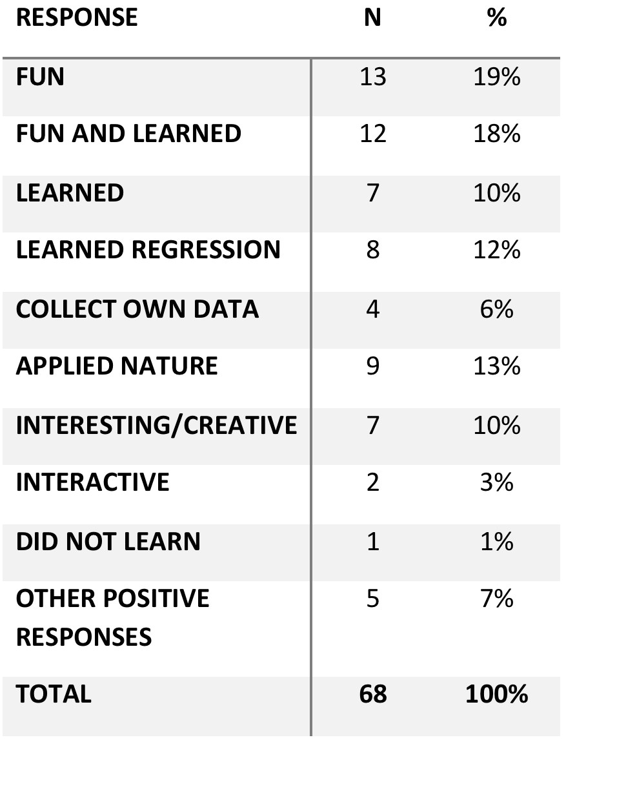
STUDENT EVALUATIONS
Nearly all students recommended using the activity again
FUN mentioned by most
LEARNING mentioned by most
Only 1 negative response

Slide 28
INSTRUCTOR EVALUATIONS
All planned to use again
Observed:
  Student engagement and interest
  Positive learning gain
USED in a variety of ways
  In class and out of class data collection
  Nature article included
  As class activity, project, even as a midterm!!!

Slide 29
An EXAMPLE
The TigerStat activity was a success!
1. 2 lectures + 1 lab talked about: correlation, least squares estimation of the line, and sampling distributions / inference for a linear model.
2. 1 lecture where I went through a multivariate example (where the response needed a log transformation).
3. I assigned most of the lab for them to do (including the game), and then I had them write up just a small bit of it.
The majority of the students really got it. I was impressed. For 1.5 weeks of presenting on linear models, they actually understood a lot of the details of model building, assessment, and interpretation. It was great!

