Slide 1
Integrating Writing in the Statistics Curriculum
Dean Poeth and Jane Oppenlander
Union Graduate College
eCOTS, May 19-23, 2014
1

Slide 2
Setting
Union Graduate College is comprised of four schools offering master’s degrees and post-baccalaureate certificates in:
Management and Healthcare Management
Engineering and Computer Science
Education
Bioethics
Effective communication (oral and written) is a required competency
There is no college-wide writing resource center
Graduate level statistics courses are offered in all schools
Required for MBA, elective for all other programs
Taught both on-line and in the classroom
2

Slide 3
Expectations
Students in professional master’s degree programs aspire to leadership positions in their fields
Communication is a core competency for professional success and upward mobility
Our programs develop writing competency across the curricula
In statistics courses we focus on writing professional quality reports and presentations that communicate the results of statistical analysis
In lay language (no statistical jargon)
In the context of the business problem
3

Slide 4
Observed Writing Issues
There is a wide range of writing skill based on:
Undergraduate major
Amount of professional work experience
Many students are unfamiliar with technical writing
Many students are unfamiliar with common professional writing formats
Technical reports
Abstracts
Journal articles
Project proposals
4

Slide 5
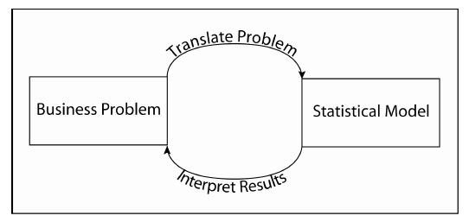
Pedagogical Approach
Problem-solving approach to statistics
Statistical analysis supports decision-making
Effectively communicating statistical results to decision-makers in the language of the business is expected.
1/3, 1/3, 1/3 guideline
Spend 1/3 of your time on developing a clear, concise problem statement, 1/3 of your time on analysis, and 1/3 of your time communicating results
5

Slide 6
Classroom Activities Include Writing
Small group activity – What is a good hospital stay?
Given a vague question small groups write out a clear and precise problem statement.
Classroom discussion of the different problem statements created from the same question illustrates the need for careful problem specification
Individual activity followed by class discussion – review business memo
Class discussion – review abstracts from published articles
On-line discussion – piloting a survey
6

Slide 7
Student Learning Assessments
Management
One page memo summarizing a descriptive analysis
Four presentation slides summarizing a test of hypothesis
Two page technical report on using simple linear regression to develop a capital asset pricing model
Three page technical paper summarizing a multiple regression case study
Bioethics
Ten question survey on a health-related topic
Final project - ten page empirical research proposal
Periodic written one page progress reports
7

Slide 8
Resources
Guidelines
Structure and content of a technical report
Constructing good survey questions
Case Study Guidance contains writing and presentation tips
Collection of published examples of reports, presentations, posters, abstracts, proposals posted on the learning management system
Internet resources
Purdue Owl project
Author instructions from journals
8

Slide 9
Evaluating Student Written Work
All assignments have a rubric for writing/presentation quality including
Structure and organization
Correct grammar and spelling
Adherence to page limits
Clear and concise writing
Writing/presentation quality account for 10-20% of assignment grade
Graded assignments comprise
90% of course grade in bioethics
70% of course grade in management
Be explicit as to what are errors and what are suggestions for improving clarity and style.
9

Slide 10
Best Practices
Be prepared to provide examples of outlines, memos, and technical reports
Don’t forget to require an outline as part of an assignment
Be explicit when precise technical language is required in writing statistical results
Assess writing no more than 10% of assignment grade
Instructors must model good writing in everything they do
Board work, tests, assignment, emails to students
Encourage proofreading and having someone else review their assignments
Early in the course give small writing assignments that have small contribution to final course grade
Allows students to become accustomed to technical writing and expectations for professional quality without undue worry about the impact on final course grade
10

Slide 11
Conclusions
Writing reinforces statistical concepts
The act of writing causes students to think about the interpretation of their results
Use of abstracts and page limits helps students recognize and focus on the key statistical information
Many students understand the importance of good writing for career success
Create a safe atmosphere to practice developing professional writing skills
Provide motivation and examples of good writing
Hold students accountable for their writing
11

