Slide 1
Special 2-year College Panel by SCHEMATYC project
Workshop Leaders:
Deborah Rumsey, The Ohio State University
Marjorie Bond, Monmouth College
Panelists:
Julie Couton, University of Nebraska - Lincoln
Stephanie Jernigan, Boston College
Naomi Schmidt, New Mexico State University
Karen Wells, Monroe Community College

Slide 2


Thanks to:
NSF Grants DUE 0942924 & 0942456
Special Thanks to Jean Scott, CAUSE Coordinator

Slide 3
Abstract
From 2011 - 2013, eight workshops involving 170 participants were presented around the country. These workshops were to improve statistical expertise and statistics teaching skills among statistics educators, especially those who teach mathematics. In the workshops, participants studied exam questions and the associated common mistakes that students make.
Through these questions, we explored - What is the statistical concept being assessed? What is the correct answer? What is the most popular incorrect answer? and for the incorrect answer(s), What's the problem? Why is it a problem? and How can we address the problem?
Participants were presented with a framework which they could take and use with their own homework and exam problems. In our session, after an introduction and example from Deborah and Marjorie, four panelists who each attended one of the workshops will present how they are using the workshop information in their classrooms.

Slide 4
Goals of the workshop
Examine some difficult concepts for students
Understand what the student sees
Analyze why students have problems
Address issues that students have when we teach the material
Learn about additional resources
Work with a group on a difficult concept and share
Make GAISE guidelines a part of everyday teaching
  Guidelines for the Assessment of Instruction
  in Statistics Education

Slide 5
Our Approach: Through a set specific statistics questions, we explore each of the following:
What is the statistical concept being assessed?
What is the correct answer?
What is the most popular incorrect answer?
For incorrect answer(s),
  What’s the problem?
  Why is it a problem?
  How can we address the problem?

Slide 6
Example Question: According to the two histograms below, which data set has more variability (e.g. a higher standard deviation)?
Data Set A has the most variability.
Data Set B has the most variability.
Both data sets have the same variability.
Not enough information to tell.

Slide 7
What is the Problem?
Correct answer is flat histogram (B) has more variability than the mound-shaped one (A)
Most common incorrect answer is the mound shaped histogram (A) has more variability than the flat one (B).
Variability in histograms is misunderstood
This will affect their understanding of variability down the road
In particular, their understanding of sampling distributions

Slide 8
Why is it a problem?
Students are very much used to time plots
Variability in histograms and time charts are opposites
  A flat time plot has no variability
  A flat histogram has variability

Slide 9
How do we address the problem?
Focus on understanding and labeling the AXES
Histogram:
  X axis is “WHAT VALUES?”
  Y axis is “HOW MANY?”
Time plot:
  X axis is “WHEN?”
  Y axis is “WHAT VALUE?”
Students may still not believe you!
  Graphs ←→ Data values
  Show an example they can’t refuse

Slide 10
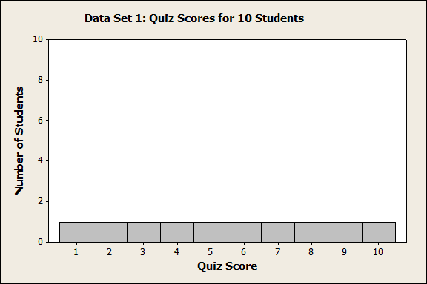
Ideas:
Create the data set for each graph and discuss
Find the standard deviations and compare
Match other graphs to their standard deviations
Choose four numbers from 1, 2, 3, 4 with lowest possible SD and highest possible SD
Show graphs and ask students to fill in the labels

Slide 11
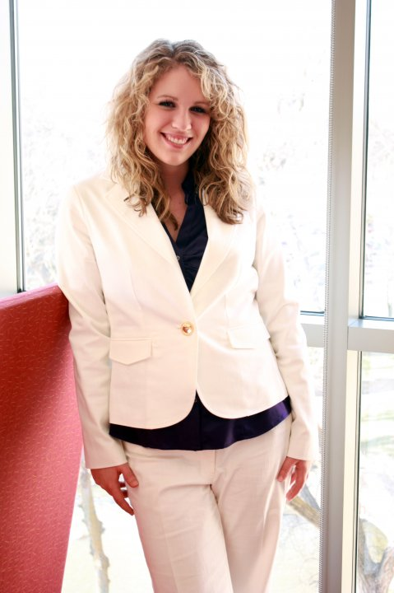
Julie Couton
University of Nebraska - Lincoln

Slide 12
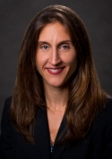
Stephanie Jernigan
Boston College

Slide 13
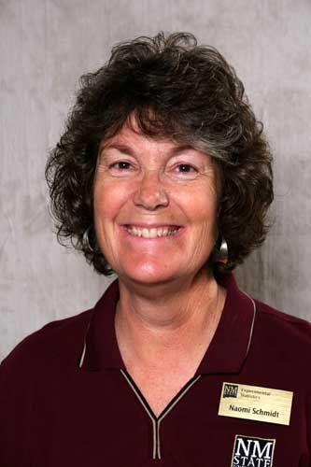
Naomi Schmidt
New Mexico State University

Slide 14
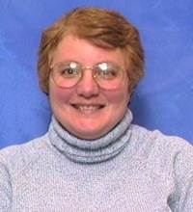
Karen Wells
Monroe Community College

Slide 15





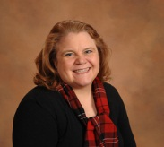
Questions:
Please submit your questions by typing in the question box.
Julie Couton
Stephanie Jernigan
Deborah Rumsey
Karen Wells
Marjorie Bond
Naomi Schmidt

Slide 16
Karen Wells
Monroe Community College

Slide 17
Questions:
Please submit your questions by typing in the question box.
Julie Couton
Stephanie Jernigan
Deborah Rumsey
Marjorie Bond
Naomi Schmidt

